Slide 1
Light Amplification by Stimulated Emission of Radiation (LASER)
Reference: Fundamentals of Applied Electromagnetics,
by Ulaby, Michielssen and Ravaioli

Slide 2
LASER versus other light sources (sun, light bulb)
LASER
Others
Monochromatic: single wavelength
Coherent: uniform wavefront
Narrow-beam
Several wavelengths
Incoherent: random phase
Wide-beam

Slide 3
Atom model
Nucleus (protons and neutrons) and electron cloud
Orbit
quantized (discrete) energy state that electron occupies
Move from lower to higher (excited) energy state
caused by supply of energy: heat or intense light
Pumping:
exciting atoms
increasing the population of electrons in higher energy states

Slide 4
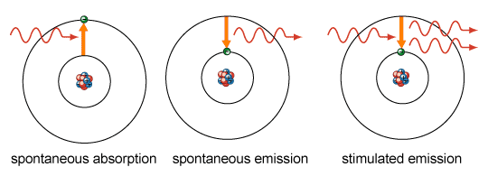
Photon emission
Spontaneous: photon in an excited state moves to a lower state
Stimulated: emitted photon interacts with an excited electron (of another atom), causing it to drop to a lower energy level
Creates a new photon with identical phase, frequency, polarization, and direction

Slide 5
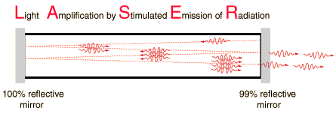
Operation principle
Flash tube: light excites the atoms, spontaneous emission, generated photons cause stimulated emission
Perfectly reflecting mirror at one end: photons (moving along the tube) bounce back, generating more stimulated emission (amplification)
Partially reflecting mirror at the other end: photons bounce back, a fraction of them go through the mirror

Slide 6
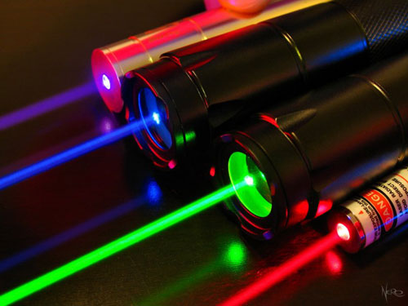
Wavelength (color)
Given material has unique energy states
Energy difference between high energy state and low energy state determines the wavelength
Bands:
Ultraviolet: 400 nm (790 THz) to 10 nm (30 PHz)
Visible: 700 nm (430 THz) to 400 nm (790 THz)
Infrared: 1 mm (300 GHz) to 700 nm (430 THz)
Microwave: 1 meter (300 MHz) to 1 mm(300 GHz)

