Slide 1
Software Defined Quantum Stream-Cipher

Slide 2
Introduction/Background

Slide 3
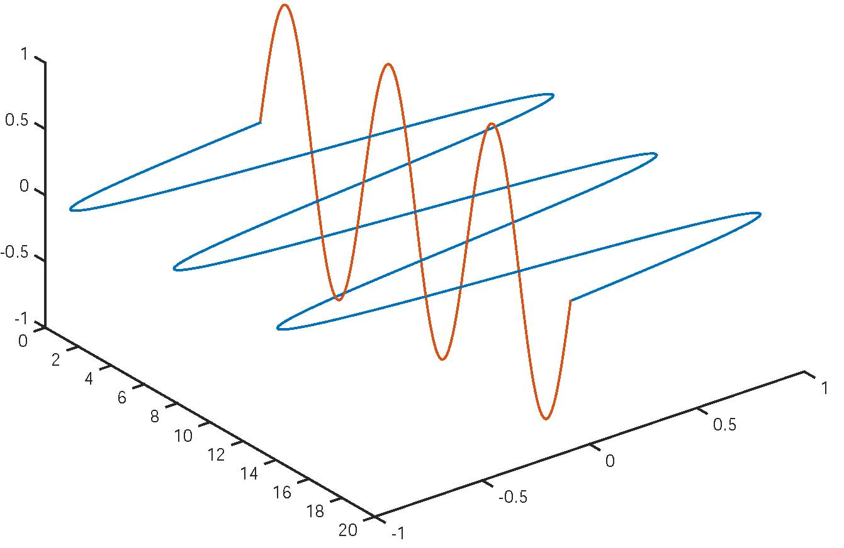
Polarization of photons
Horizontal (blue) and vertical (red)
Bases, encoding and filters

Slide 4
Photon filtering example

Slide 5
SD Quantum Stream-Cipher

Slide 6
Why software-defined quantum communications?
Extension of the software-defined radio paradigm to quantum communications
implement in software, communication functions traditionally realized with complex hardware
more versatile, more control abilities and more advanced features
GNU Radio Conference, 2011
GNU Radio for Quantum Optical Communications - Dr. Travis Humble

Slide 7
Why may this design be interesting?
Solve a quantum communication problem with the software-defined approach
Combine QKD with classical stream-cipher encryption
Simulate a communication problem with GNU radio and
Implement in GNU radio a system with feedback

Slide 8
Stream-cipher logic
Secret bit-string key
same length as the message to be encrypted and communicated
single use
source and destination use the same
Ciphertext
exclusive or of plaintext message and secret bit-string key
Plaintext recovery
a second exclusive on the ciphertext and secret bit-string key

Slide 9
Architecture of the software-defined quantum stream-cipher
Quantum communications and cryptography used to distribute secret bit-string key, in accordance with the principles of the BB84 QKD protocol.

Slide 10
Behavior of encoder (1)

Slide 11
Behavior of encoder (2)

Slide 12
Behavior of encoder (3)

Slide 13
Behavior of encoder (4)

Slide 14
Handling of positive feedback

Slide 15
Handling of negative feedback

Slide 16
Handling of ciphertext messages by the decoder

Slide 17
Flow of incoming photons and bases to the decoder and flow of outgoing feedback messages from the decoder

