Slide 1
Overview of
Software-Defined Radio
Michel Barbeau
School of Computer Science
Carleton University

Slide 2
Content
SDR architecture
Signal processing
  Signal generation
  Frequency range sweep generator
  In-phase(I) & quadrature (Q) signals
  Comb & FIR filter
  Spectrum analysis/display
Implementation

Slide 3
SDR Architecture

Slide 4
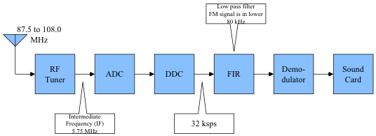
SDR FM Broadcast Receiver

Slide 5
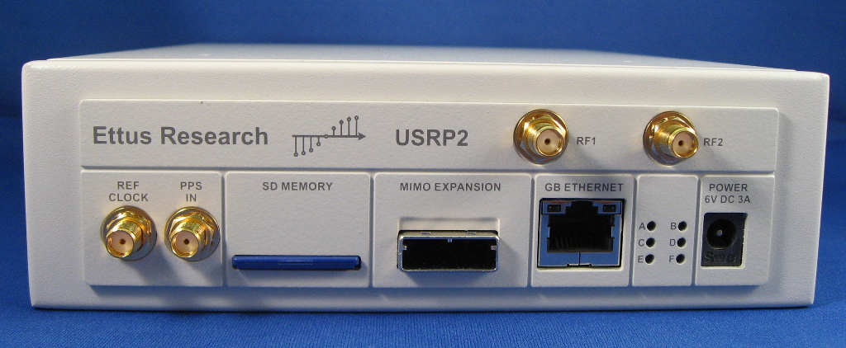
Universal Software Radio Peripheral (USRP)

Slide 6
What you need to understand
Wireless communications systems
Hardware architecture
Signal processing
Object-oriented programming

Slide 7
Signal Processing

Slide 8
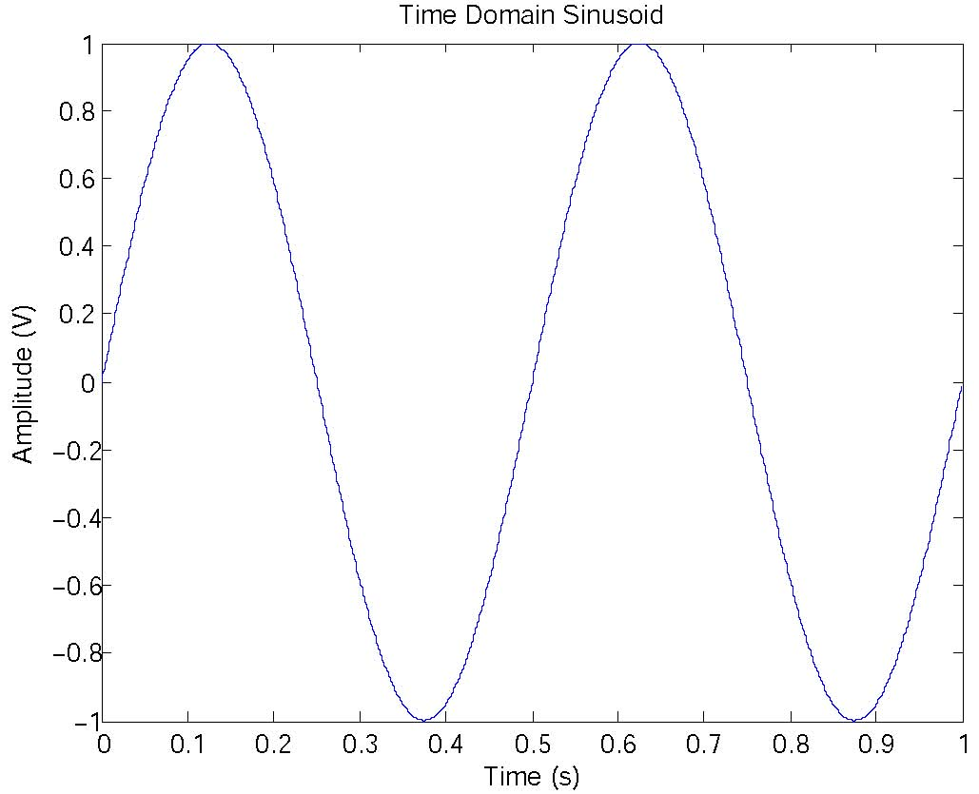
Signal Generation

Slide 9
Signal Generation (sine.m)
% Create an array of 1000 time instants, in steps of 0.001 s.
time=[0:999]*0.001;
% Create a wave at frequency f
f=2; % Hz
signal=sin(2*pi*f*time);
Notes:
addpath("/Users/michelbarbeau/Documents/Presentations/2010/SDR")

Slide 10
Exercise
Nyquist minimum sampling rate is equal to twice the highest frequency contained within a signal.
Change the signal in the example such that the frequency is the maximum possible under Nyquist condition.
Over sample to twice Nyquist criterion

Slide 11
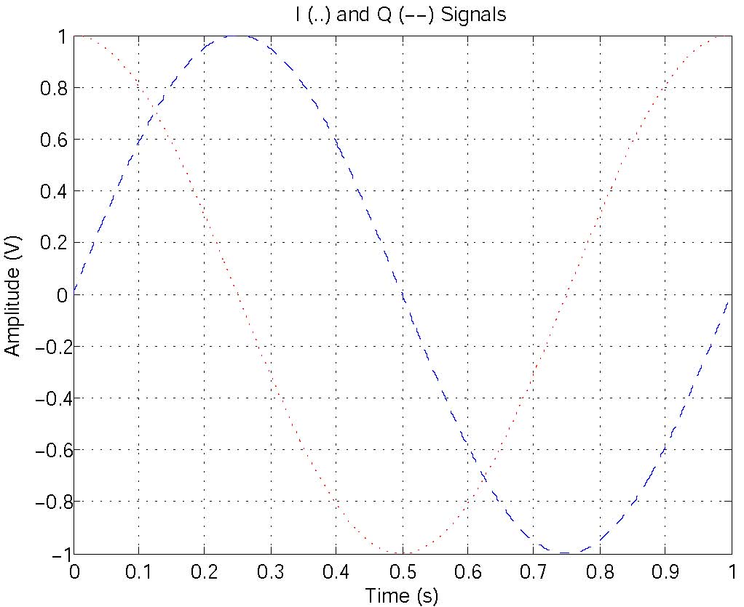
In-phase(I) & Quadrature (Q) Signals (IandQ.m)

Slide 12
In-phase(I) & Quadrature (Q) Signals (IandQ.m)
% Create an array of 1000 time instants, in steps of 0.001 s.
time=[0:999]*0.001;
% Create the in-phase (I) signal at frequency f
f=1; % Hz
Isignal=cos(2*pi*f*time);
% Create the quadrature (Q) signal
Qsignal=sin(2*pi*f*time);

Slide 13
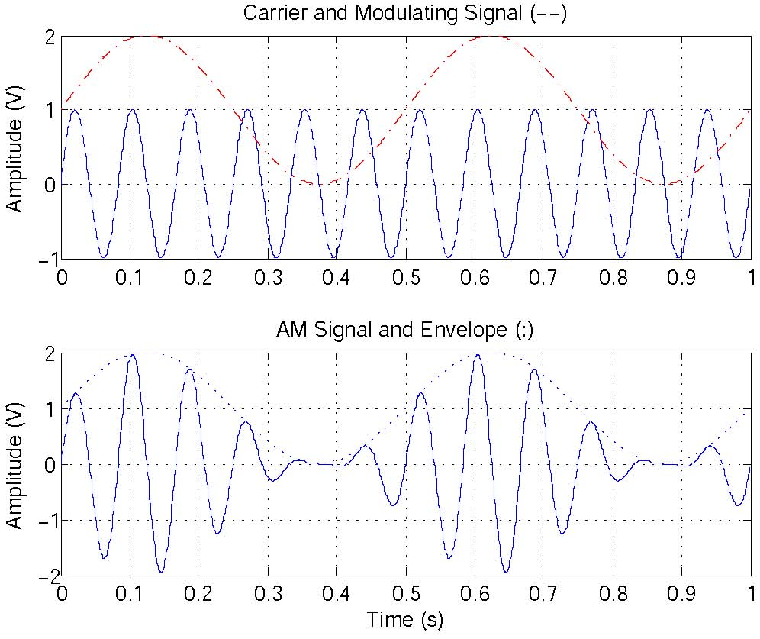
Amplitude Modulation (AM)

Slide 14
Amplitude Modulation (AM) (AM.m)
% Create an array of 1000 time instants, in steps of 0.001 s.
time=[0:999]*0.001;
% Create a carrier signal at frequency f
f=12; % Hz
carrier=sin(2*pi*f*time);
% Create a modulating signal at frequency g
g=2; % Hz
modulation=1+sin(2*pi*g*time);
% Modulation depth
m=1; % 100% modulation
% Multiply the modulating signal by the carrier
signal=m*modulation.*carrier;

Slide 15
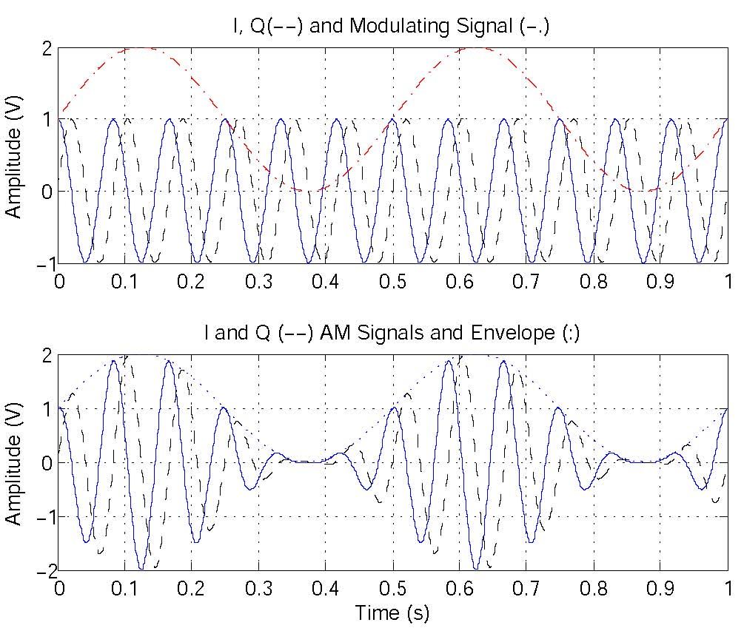
AM Using the I & Q Signals

Slide 16
AM Using the I & Q Signals (AMQ.m)
% Create an array of 1000 time instants, in steps of 0.001 s.
time=[0:999]*0.001;
% Create a carrier signal
f=12; % Hz
% Create an in-phase carrier
Icarrier=cos(2*pi*f*time);
% Create a quadrature carrier
Qcarrier = sin(2*pi*f*time);
% Create modulating signal
g=2; % Hz
modulation=1+sin(2*pi*g*time);
% Modulation depth
m=1; % 100% modulation
% Multiply the modulation by the carrier
Isignal=m*modulation.*Icarrier;
Qsignal=m*modulation.*Qcarrier;

Slide 17
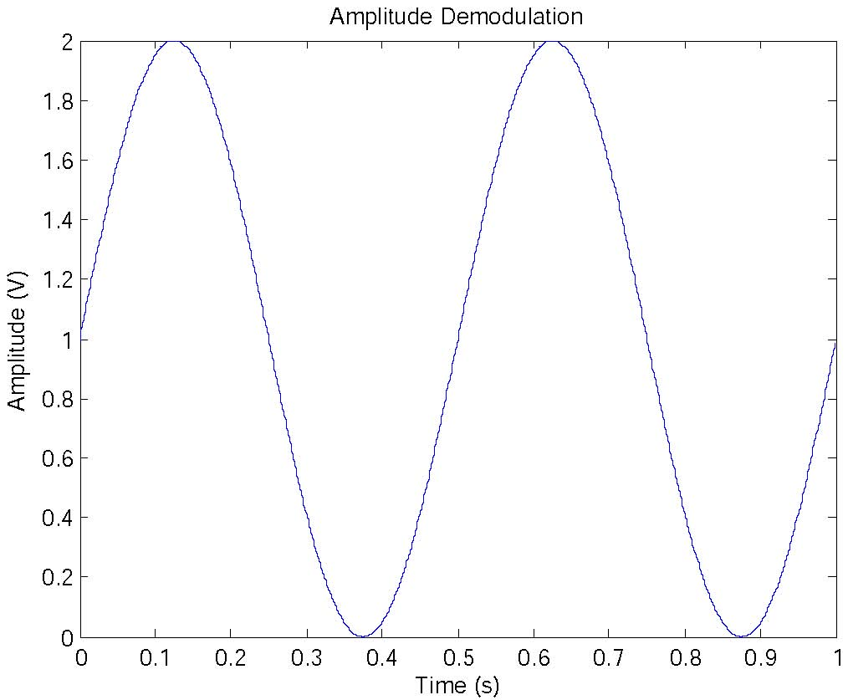
AM Demodulation

Slide 18
AM Demodulation (DAM.m)
demodulation = sqrt((Isignal).^2 + (Qsignal).^2);

Slide 19
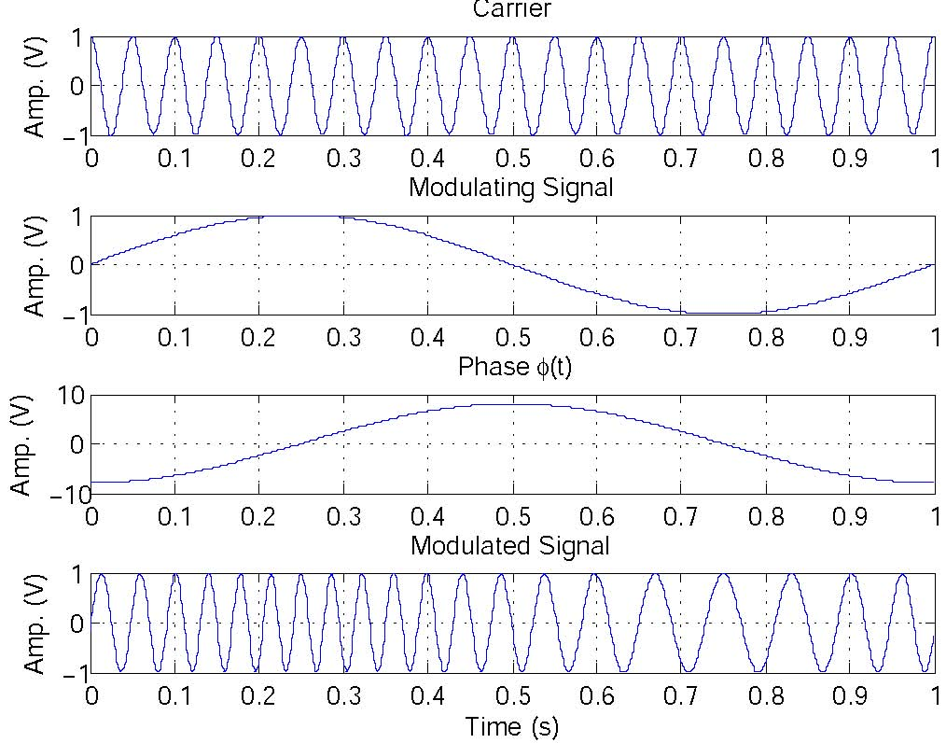
Frequency Modulation (FM)

Slide 20
Frequency Modulation (FM_I_and_Q.m)
% Create an array of 1000 time instants, in steps of 0.001 s.
time=[0:999]*0.001;
% Create a carrier signal at frequency f
f=20; % Hz
% Create an in-phase carrier
Icarrier=cos(2*pi*f*time);
% create a quadrature carrier
Qcarrier=sin(2*pi*f*time);
% Modulation index
m=16*pi;
% create a modulating signal at frequency g
g=1; % Hz
modulatingsignal = sin(2*pi*g*time);
% Frequency modulation
modulation=-m/(2*pi*g)*cos(2*pi*g*time);
% Create the modulated signal
Isignal=cos(2*pi*f.*time + modulation);
Qsignal=sin(2*pi*f.*time + modulation);

Slide 21
FM Demodulation (DFM.m)
% Get the number of time instants
L=length(time);
% Compute the numerator
numerator = Qsignal(2:L).*Isignal(1:L-1) - Isignal(2:L).*Qsignal(1:L-1);
% Compute the denominator
denominator = Isignal(2:L).*Isignal(1:L-1) + Qsignal(2:L).*Qsignal(1:L-1);
% Take the ratio of the numerator and denominator
demodulation = numerator ./ denominator;

Slide 22
Phase Modulation

Slide 23
Comb Filter
Building blocks
  Delay element: store and release after a delay d
  Adder C = A + B
Equation
  Out(t) = In(t) + In(d)

Slide 24
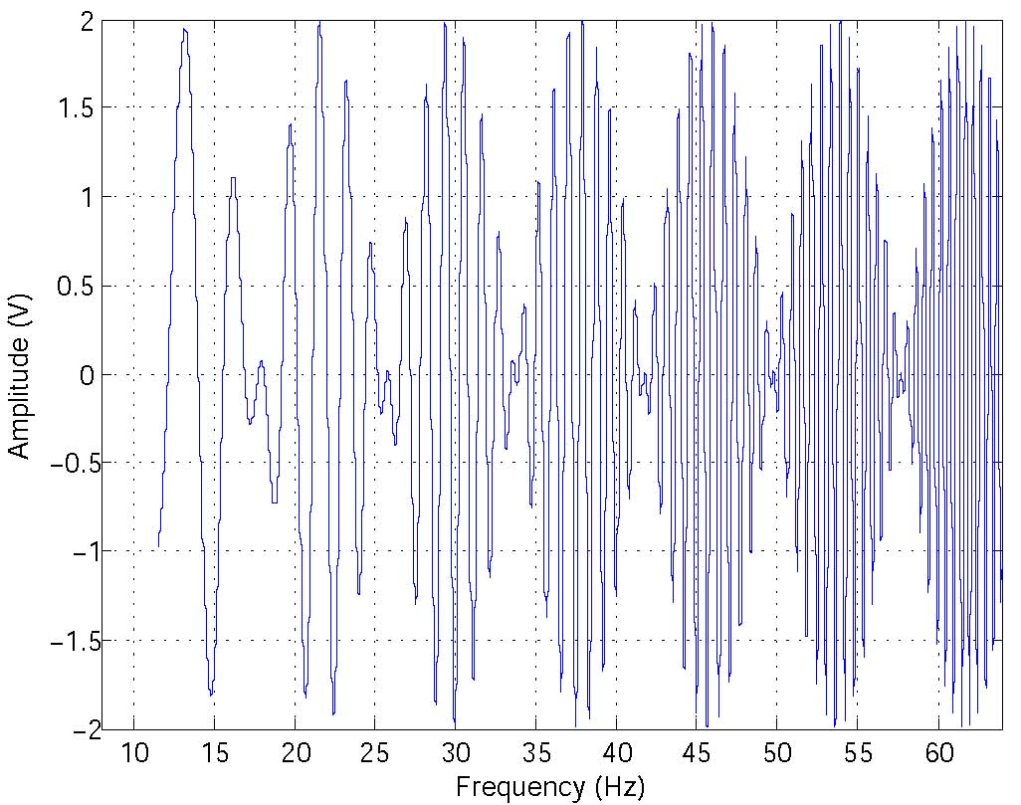
Comb Filter

Slide 25
Comb Filter (COMB.m)
% Set the number of time instants
L=4096;
% Create an array of time instants
time=[0:L-1]*1/L;
% Lower and upper frequencies
f=[ 8 64 ]; % Hz
frequency=f(1)+((f(2)-f(1))/(time(L)-time(1))).*time;
% Generate a sweep signal
signal=sin(2*pi*frequency.*time);
% Filter delay (in samples)
d=256; % notches at multiple of 8 Hz
out=signal(d+1:L)+signal(1:L-d);

Slide 26
Finite Impulse Response (FIR) filter
Equation
  Out(t) = a0*In(t) + a1*In(d1) + …+ an*In(dn)

Slide 27
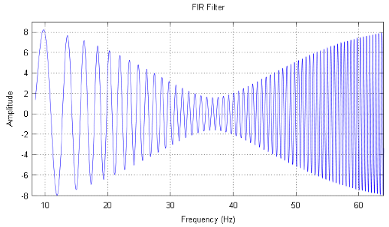
Finite Impulse Response (FIR) filter

Slide 28
Finite Impulse Response (FIR) filter
% Set the number of time instants
L=4096;
% Create an array of time instants
time=[0:L-1]*1/L;
% Lower and upper frequencies
f=[ 8 64 ]; % Hz
frequency=f(1)+((f(2)-f(1))/(time(L)-time(1))).*time;
% Generate a sweep signal
signal = sin(2*pi*frequency.*time);
% Coefficients
a0=0.5;
a5=2.5;
a35=5;
% Filter delays (in samples)
d5=5;
d35=35;
out=a0*signal(d35+1:L) + a5*signal(d35-d5+1:L-d5) + a35*signal(1:L-d35);

