Slide 1
Chapter 15
Cognitive Radio Networks

Slide 2
What is a cognitive radio?
Software Defined Radio (SDR)
Hardware : antenna, preselector, power amplifier, ADC, DAC, computer
Software : filters, (de)modulators, user interface
Artificial Intelligence (AI)
Mimicking human thinking with machines
SDR + AI
Radio senses channel conditions, understands operator's preferences, use past experience, determine operation parameters

Slide 3
Why smart radio networks?

Slide 5
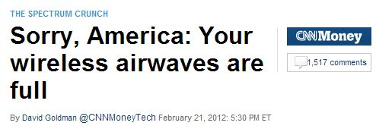

Slide 6
The Spectrum Crunch Problem
Global Mobile Data Traffic, 2014 to 2019
Overall mobile data traffic is expected to grow to 24.3 exabytes per month by 2019,
nearly a tenfold increase over 2014. Mobile data traffic will grow at a rate
of 57 percent from 2014 to 2019.
Source: Cisco VNI Mobile, 2015

Slide 7
Spectrum Crunch (cont'd)
High-End Devices Significantly Multiply Traffic
Source: Cisco VNI Mobile, 2015

Slide 8
Comparison of Global Device Unit Growth and Global Mobile Data Traffic Growth 2014–2019
Device Type | Growth in Devices | Growth in Mobile Data Traffic
Smartphone | 16.7% | 60.1%
Tablet | 32.0% | 83.4%
Laptop | 5.3% | 22.3%
M2M Module | 45.5% | 102.7%
Machine-to-machine (M2M) connections: home and office security and
automation, smart metering and utilities, maintenance, building automation,
automotive, healthcare and consumer electronics.
Source: Cisco VNI Mobile, 2015

Slide 9
But...over 80% of spectrum is unused

Slide 10
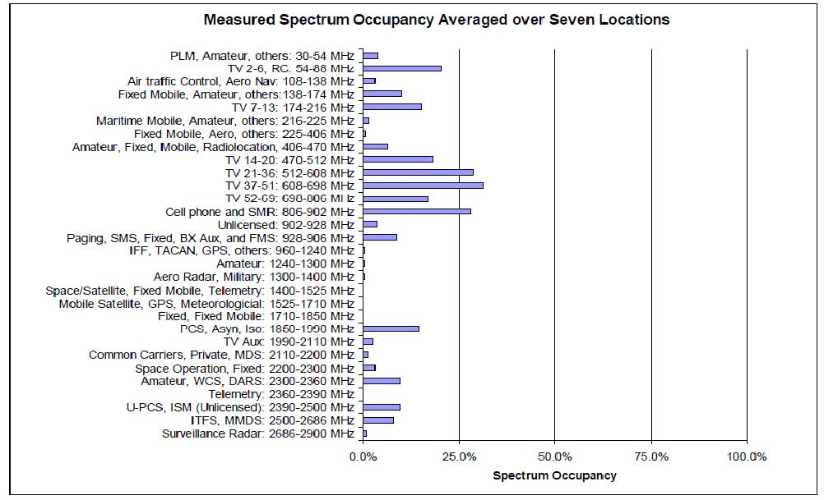

Slide 11
Cognitive Radio
More efficient use of radio spectrum
Support of the expected growth of wireless trafic
SDR+AI : smart radios that can use radio spectrum smartly

Slide 12
Examples
Opportunistic spectrum usage of television white space
Interference temperature for interference control

Slide 13
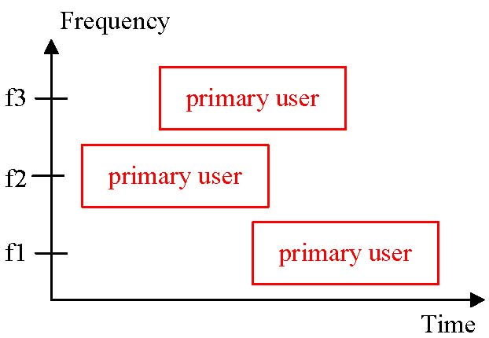
Opportunistic Spectrum Usage

Slide 14
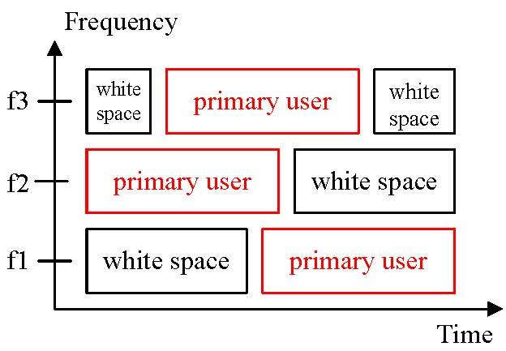
Opportunistic Spectrum Usage

Slide 15
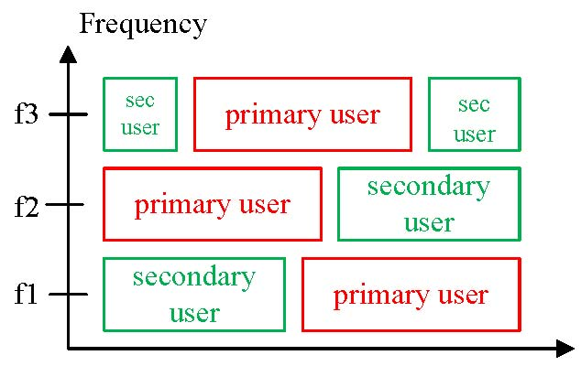
Opportunistic Spectrum Usage

Slide 16
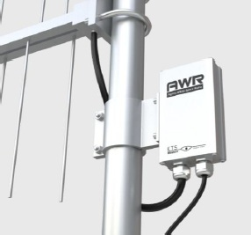
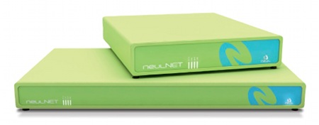
WhiteFi (802.11af)
Uses spectrum previously occupied by analog TV channels
Rates 1.5 to 3.1 Mbps
Municipal functions : surveillance cameras, transmitting water quality data
VHF frequencies from 174 to 216 MHz (TV channels 7-13),
UHF frequencies from 470–698 MHz (TV channels 14-52), and
unlicensed frequencies from 902 to 928 MHz

Slide 17
Super Wi-Fi (802.22)
Wireless Regional Area Net
Use cognitive radio and TV white space (54-862 MHz) to provide broadband to low-population-density areas
Range 30 km, PSK, QAM, OFDM, 1.5 Mbps (downstream), 384 Kbps (upstream), BW 6, 7 or 8 MHz

Slide 18
Where is the white space?
The database approach!
Secondary users query a DB (via Internet) to find available channels
Secondary users provide their geographic location
Projects : IETF Protocol to Access White Space DB (PAWS); Microsoft, Google White Space DB
The spectrum sensing approach!
Observe the spectrum
Identify non occupied channels

Slide 19
How to control interference?
Current approach
power limit on individual transmitters
Others
Interference temperature approach: a maximum on the cumulative energy from the transmitters
...

Slide 20
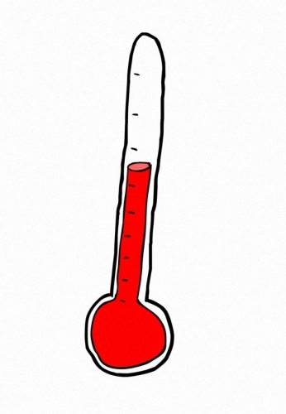
Interference
Temperature

Slide 21
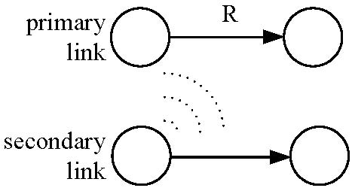
Interference Temperature
Data rate R is proportional to
Power of primary transmitter
...but inversely proportional to
Noise
Interference from secondary transmitter

Slide 22
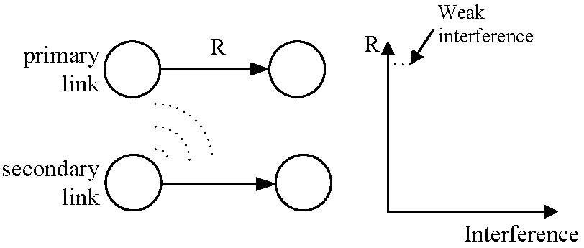
Interference Temperature (cont'd)

Slide 23
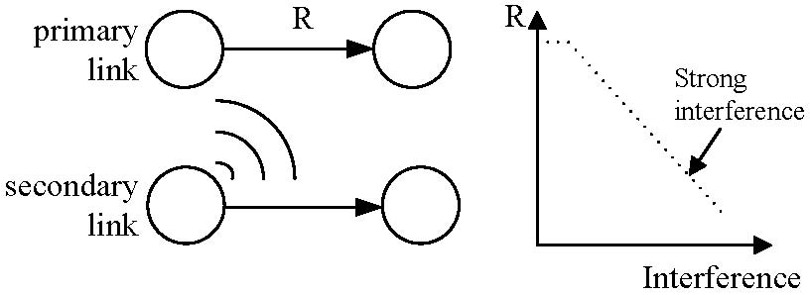
Interference Temperature (cont'd)

Slide 24
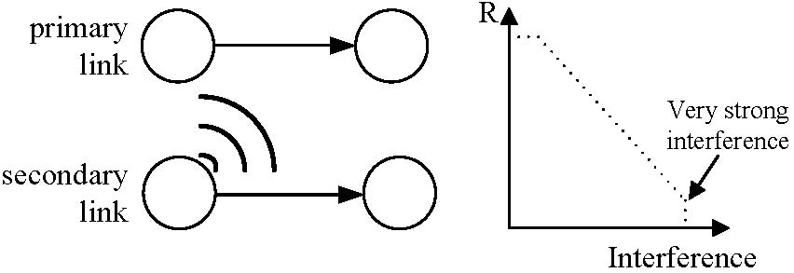
Interference Temperature (cont'd)

Slide 25
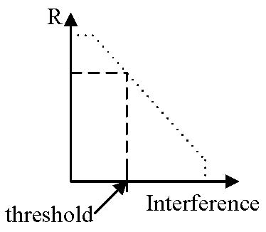
Interference Temperature (cont'd)

Slide 26
Interference Temperature (cont'd)
Limitation
Current model doesn't take into account receiver's sensitivity

