Slide 1
Signals
Notes:
1
1

Slide 2
ELECTROMAGNETIC INDUCTION
Notes:
2
2

Slide 3
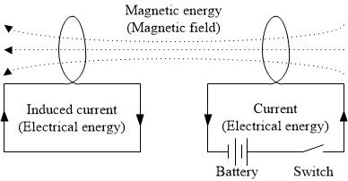
Faraday’s Law& Lenz’s Law
Notes:
3
3

Slide 4
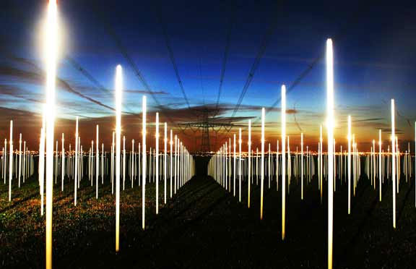
Notes:
4
4

Slide 5
Time Domain
REPRESENTATION OF SIGNALS
Notes:
5
5

Slide 6
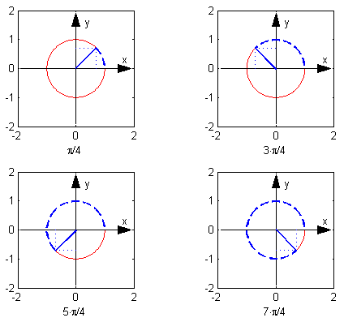
Signal, amplitude and phase
Notes:
6
6

Slide 7
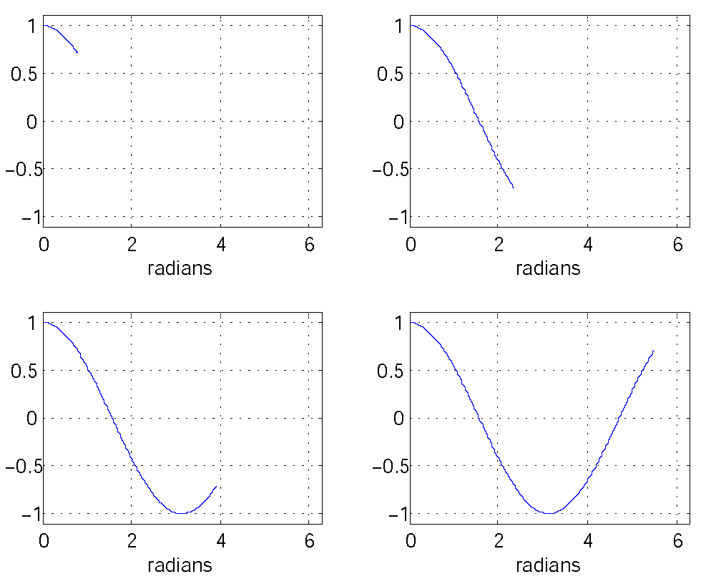
Amplitude of signal as a function of phase

Slide 8
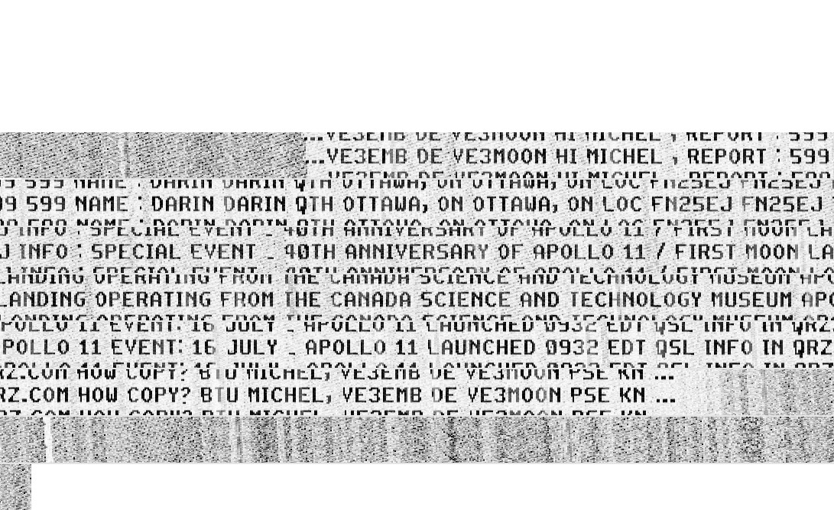
Hellschreiber painted text
Each character is sent on a double line, improving the ability to read the characters under a noisy channel, communicated as a series of dots. A black (white ) dot is coded as 900 (980) Hertz tone. The tones modulate in amplitude a RF carrier. Is signaling analog or digital? Is the data analog or digital?
Notes:
8
8

Slide 9
FREQUENCY DOMAIN REPRESENTATION OF SIGNALS
Notes:
9
9

Slide 10
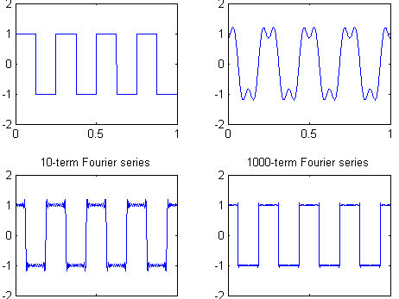
The square signal and its generation using sin-generated signals.
Notes:
10
10

Slide 11
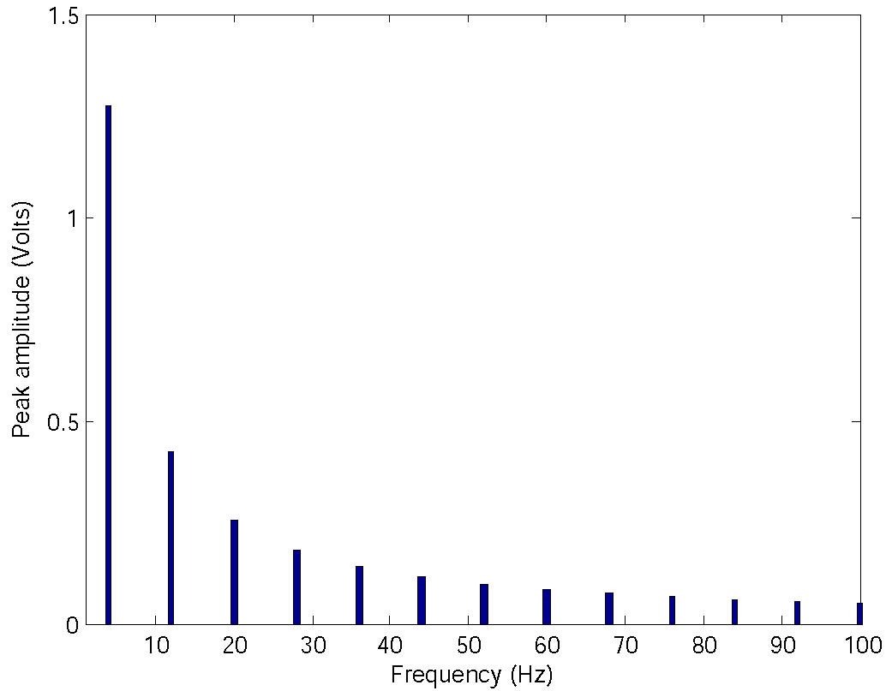
Frequency domain representation of the square signal
Notes:
11
11

Slide 12
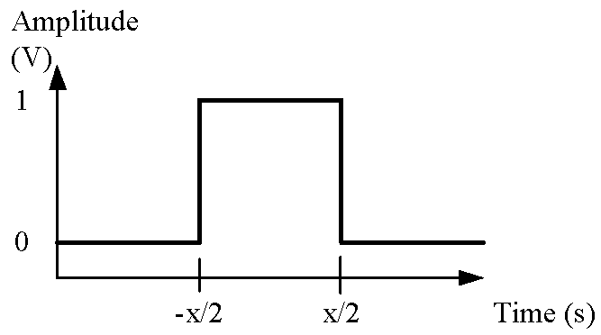
A square pulse of length x second, from time -x/2 to time x/2
Notes:
12
12

Slide 13
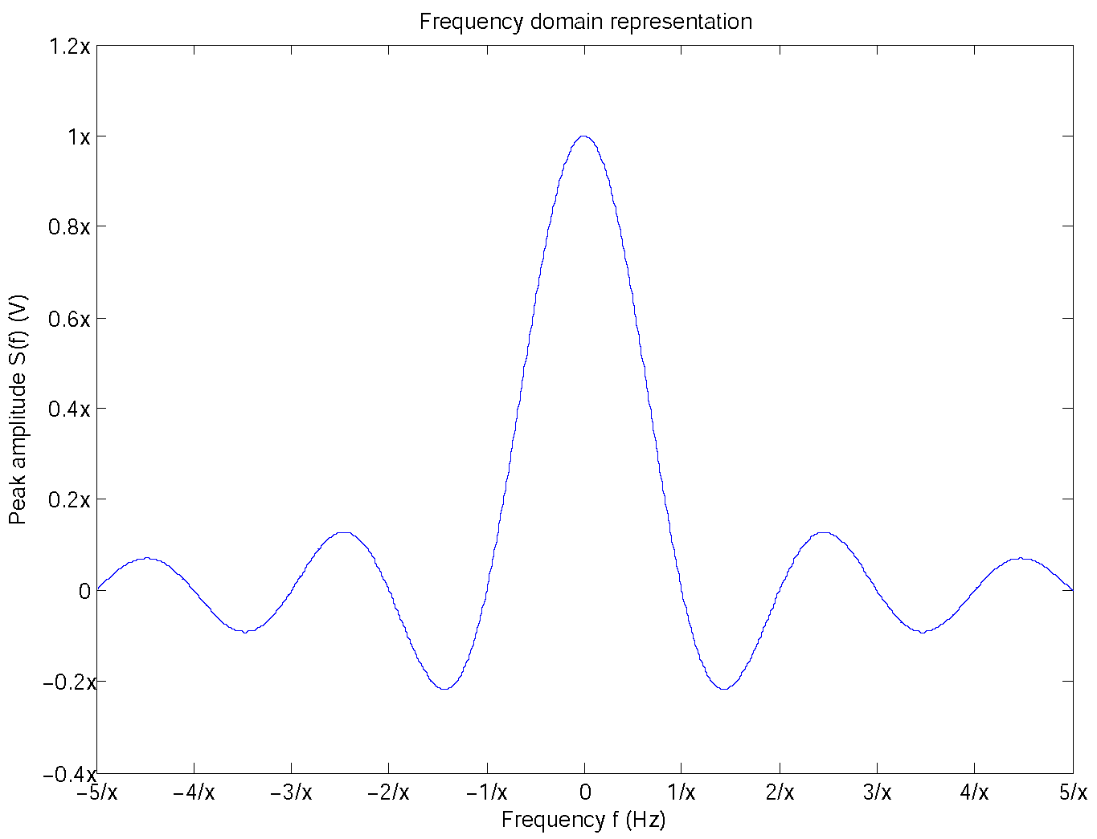
Spectrum of a square pulse of length x second, from time -x/2 to time x/2
Notes:
13
13

Slide 14
ANTENNAS
Notes:
14
14
14

Slide 15
What is an antenna?
A converter:
Transmitter: radio-frequency (RF) electrical energy to electromagnetic energy
Receiver: electromagnetic energy and to electrical energy
Two-way communications:
two antennas or
single transmission/reception antenna
Notes:
15
15
15

Slide 16
Wavelength
In free space, distance traveled during one period
Velocity: speed of light (c)
Notes:
16
16
Wavelength proportional size: distinguishes antennae from from other electronic circuits.
Conversion is optimal at resonance.
Resonance (inductive reactance and captive reactance are equal in magnitude and cancel) when the antenna length is a whole number fraction of the wavelength (1/2, 1/3, ¼).
16

Slide 17
Antenna Gain
Output power, in a particular direction, relative to that produced by an isotropic antenna
A ratio of powerS
In dBi:
Notes:
17
17
Example gains: dipole or vertical 2 dBi, Yagi 12 dBi
17

Slide 18
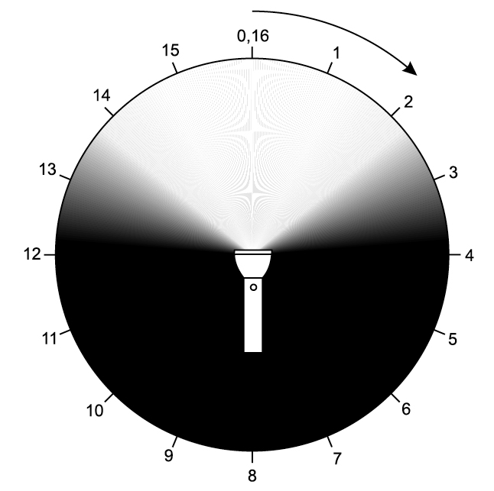
Directivity and Gain Flashlight Analogy
Notes:
18
18
Flashlight Analogy
Flashlight shinning in a dark room
18

Slide 19
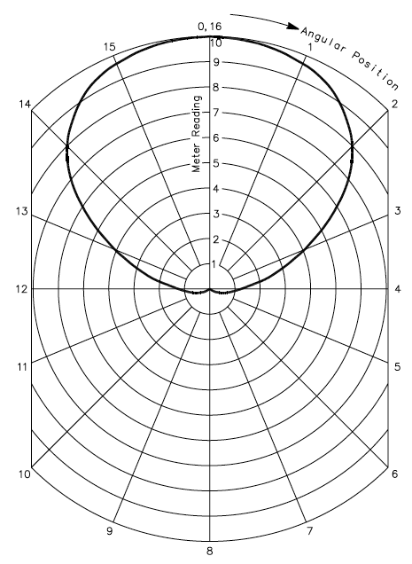
Radiation Pattern
Notes:
19
19
Right
Radiation Pattern (Polar) Graph:
- Models the antenna performance
- Field intensity, at fixed distance, as a function direction
Light meter, graduated in units from zero to 10 (full scale, in front of the flashlight)
Antenna Pattern Measurement
Antenna is fed with power, field-strength meter indicates amount of signal
Reciprocity: transmitting and receiving patterns are the same
19

Slide 20
Types of Antennas
Isotropic
Idealized, point in space
Radiates power equally in all directions
Dipole
Half-wave dipole (Hertz antenna)
Omnidirectional
2D isotropic
Vertical, 1/4 –wave monopole, Marconi, groundplane
Directional
Yagi
Parabolic reflective
Notes:
20
20
Isotropic
Means same values in all direction (iso=same; tropic=direction)
The term modeling the surface of a sphere (4 pi R^2) can be isolated from free space loss model (4 pi R / lambda) ^2
- Theoretical antenna as reference for comparison purposes
Dipole
Length is ½ wavelength
Two ¼ elements, set 180 degrees from each other, center-fed
Omnidirectional
One vertical ¼ wavelength element, ground plane is the other half (counterpoise)
Advantage: antenna is smaller, small footprint
Used in potable devices, circuit board is ground plane
May be even shortened using coils, but bandwidth is reduced (e.g., by a factor of 10)
20

Slide 21
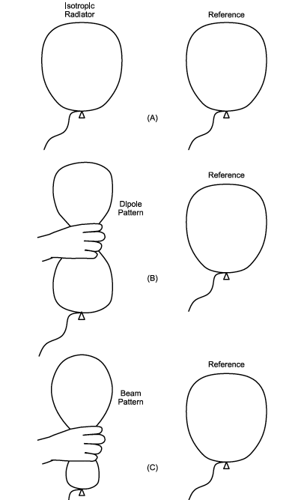
Antenna Patterns
Notes:
21
21
Isotropic antenna: perfect spherical shape, theoretical (reference), a point, infinitely small, radiates equally in all directions (a practical antenna displays directivity)
Dipole: balloon squeezed in he middle, top and bottom levels larger than isotropic
Beam: bottom end is squeezed, even more gain at top (compared to isotropic)
21

Slide 22
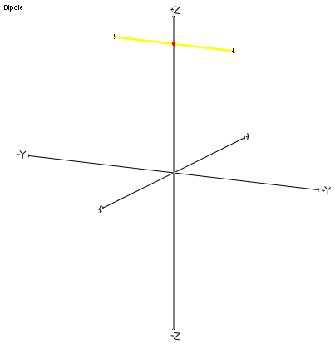
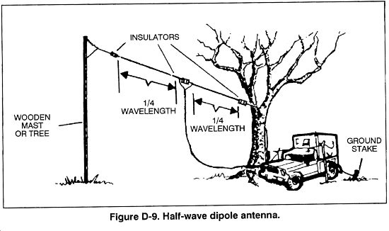
Geometry of the Dipole
Notes:
22
22

Slide 23
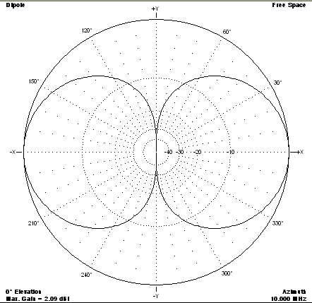
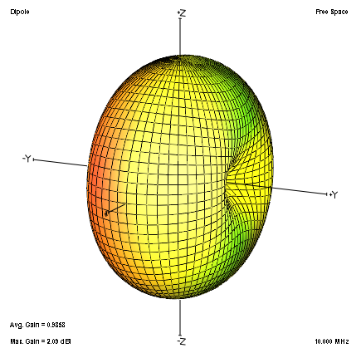
Radiation Pattern of the Dipole
Notes:
23
23
In 3D, radiation pattern (surface of equal power around the antenna) is a doughnut
Logarithmic scale is used
23

Slide 24
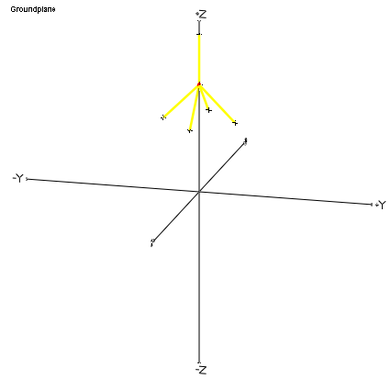
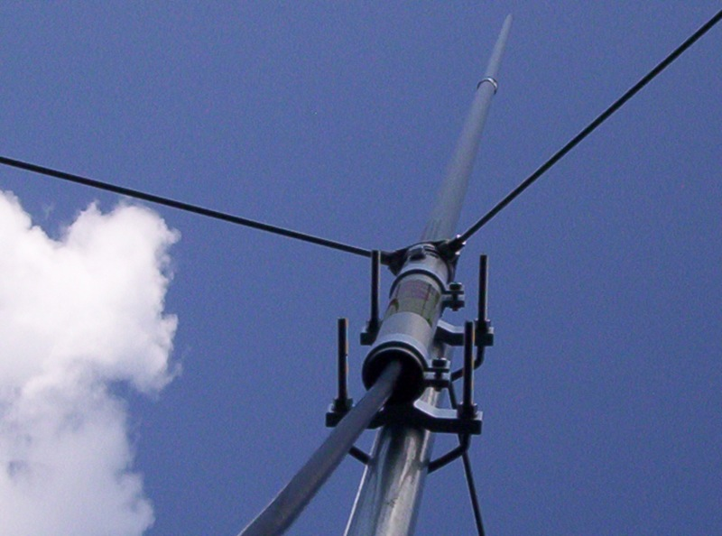
Geometry of the Groundplane
Notes:
24
24

Slide 25
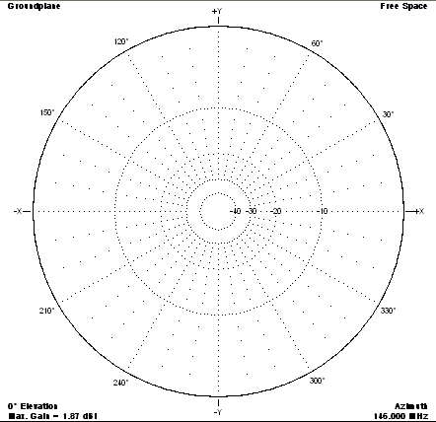
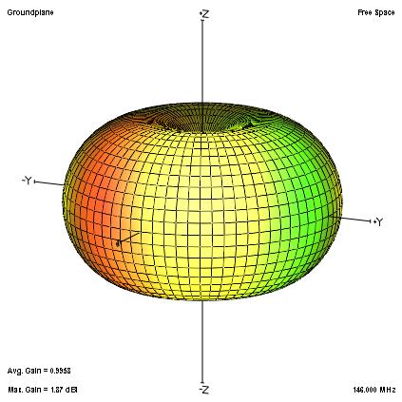
Radiation pattern of the Groundplane
Notes:
25
25
When on a ground plane, doughnut is cut in half with the antenna sticking from the middle.
Actual pattern is influenced by the surface on which the antenna is mounted, perfect doughnut is rarely obtained
25

Slide 26
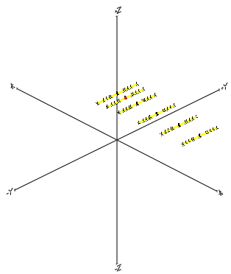
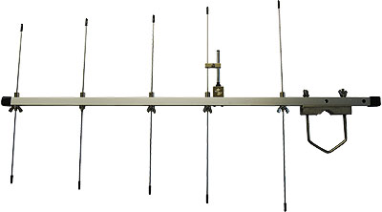
Geometry of the Yagi
Notes:
26
26

Slide 27
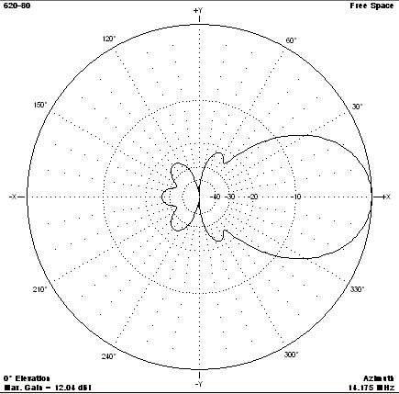
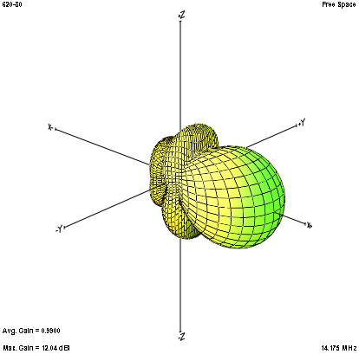
Radiation pattern of the Yagi
Notes:
27
27

Slide 28
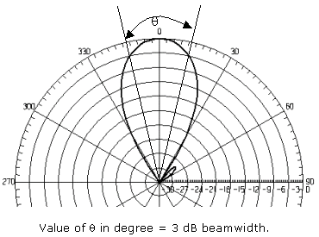
Beamwidth
Notes:
28
28

Slide 29
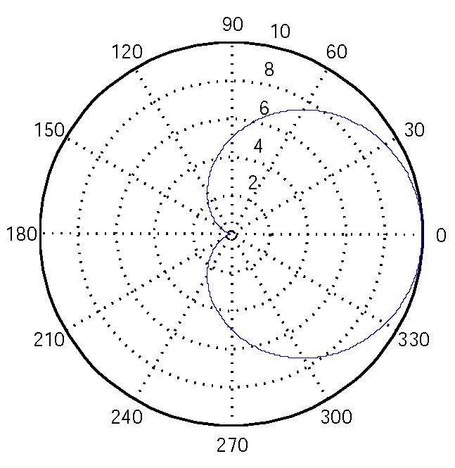
What is the beamwidth?
Notes:
29

Slide 30
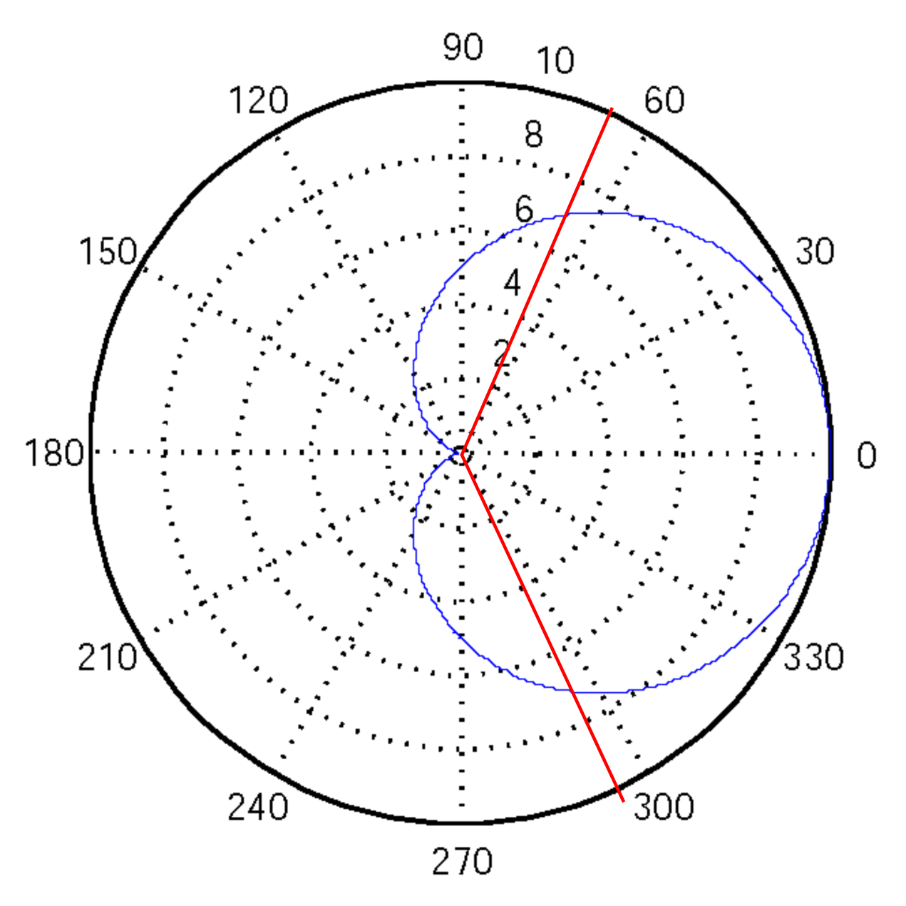
Notes:
30

Slide 31
PROPAGATION
Notes:
31
31

Slide 32
Propagation Modes
Ground-wave
Sky-wave
Line-of-sight
Notes:
32
32

Slide 33
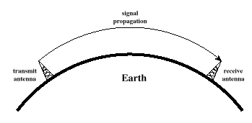
Ground Wave Propagation
Notes:
33
33

Slide 34
Ground Wave Propagation
Follows contour of the earth
Diffraction: bending of waves around obstacles
Example: AM radio (day time)
Long distances are possible, but high power required
Notes:
34
34

Slide 35
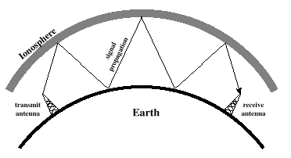
Sky Wave Propagation
Notes:
35
35

Slide 36
Sky Wave Propagation
Signal reflected from ionized layer (ionized atoms) of upper atmosphere (160 to 500 km) back down to earth
Signal can travel a number of hops, back and forth between ionosphere and earth’s surface
Reflection effect caused by refraction
Refraction: medium of one density to a medium of another density causes bending of waves
Examples
Amateur radio, CB radio, short wave broadcast
Drawback
Not reliable, conditions vary considerably as a function of day time and time of the year
Notes:
36
36

Slide 37
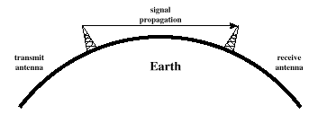
Line-of-Sight Propagation
Notes:
37
37

Slide 38
Line-of-Sight (LOS) Propagation
Transmitting and receiving antennas must be within line of sight
Terrestrial communications
antennas within effective line of sight
Satellite communications – signal from
30 MHz (downlink)
150 MHz (uplink, not reflected by ionosphere)
Notes:
38
38

Slide 39
LOS Propagation Distance
Optical line of sight
Effective, or radio, line of sight
d = distance between antenna and horizon (km)
h = antenna height (m)
K = adjustment factor to account for refraction, rule of thumb K = 4/3
Notes:
39
39

Slide 40
LOS Propagation Distance
Maximum distance between two antennas for LOS propagation:
h₁ = height of antenna one
h₂ = height of antenna two
Notes:
40
40

Slide 41
Channel Capacity
Nyquist
Shannon

Slide 42
Impairments
Attenuation and attenuation distortion
Free space loss
Noise
Atmospheric absorption
Multipath
Refraction
Thermal noise
Notes:
42
42

Slide 43
Attenuation
Signal strength drops with distance and frequency
Received signal strength must be:
at least equal to receiver sensitivity
(several times) higher than noise errorless reception
Notes:
43
43

Slide 44
Free Space Loss
λ = wavelength (in meters)
d = separation distance (in meters)
c = speed of light (3 × 10⁸ m/s)
Notes:
44
44

Slide 45
Free Space Loss (dB)
Notes:
45
45

Slide 46
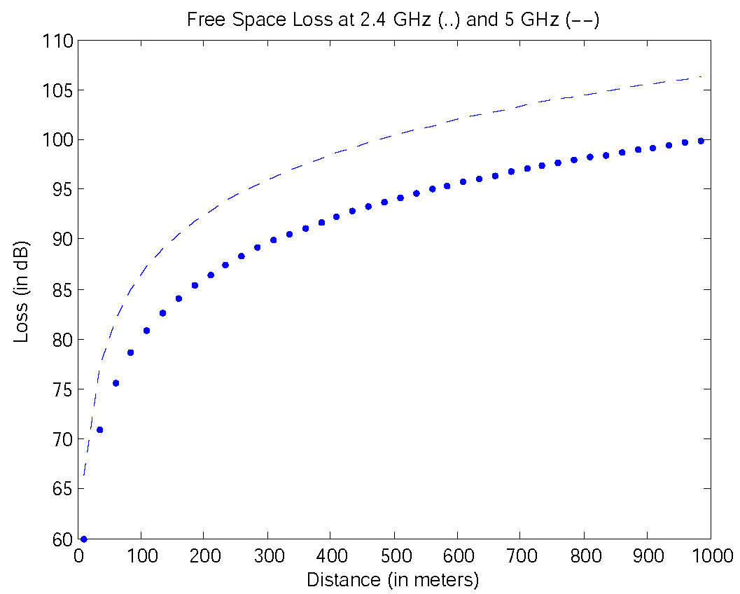
Free space loss at 2.4 GHz and 5 GHz as a function of distance

Slide 47
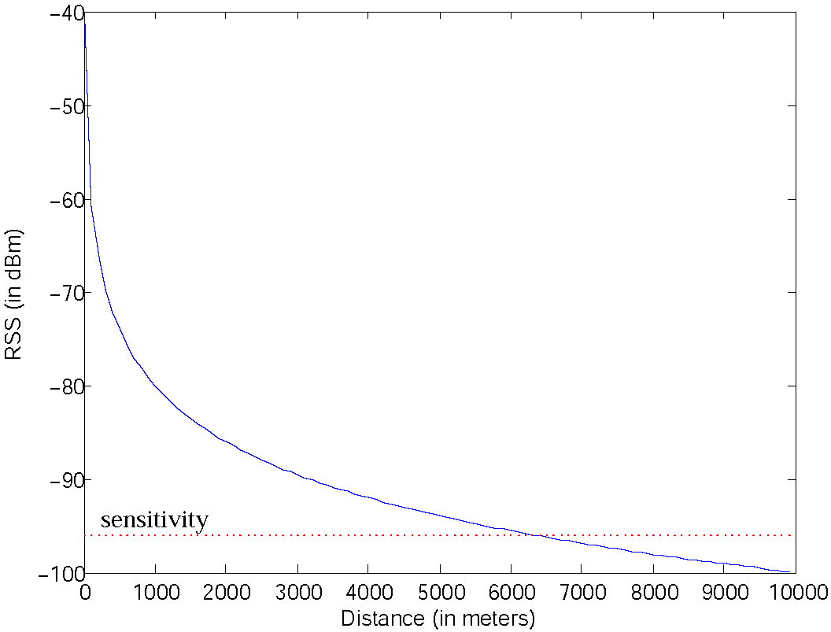
RSS as a function of distance

Slide 48
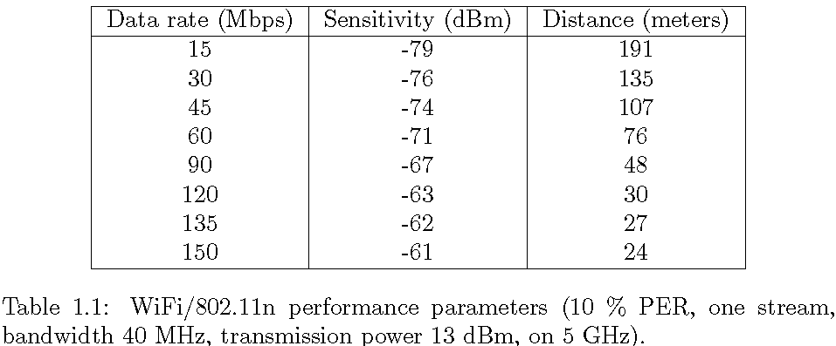

Slide 49
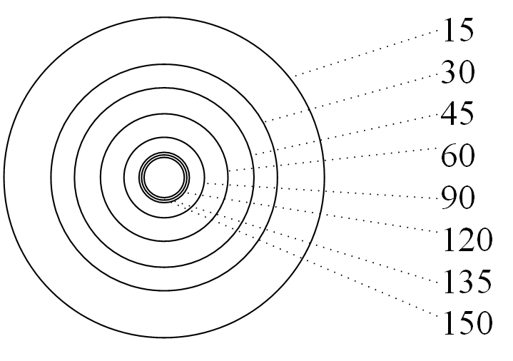
Range as a function of the data rate for WiFi/802.11n

Slide 50
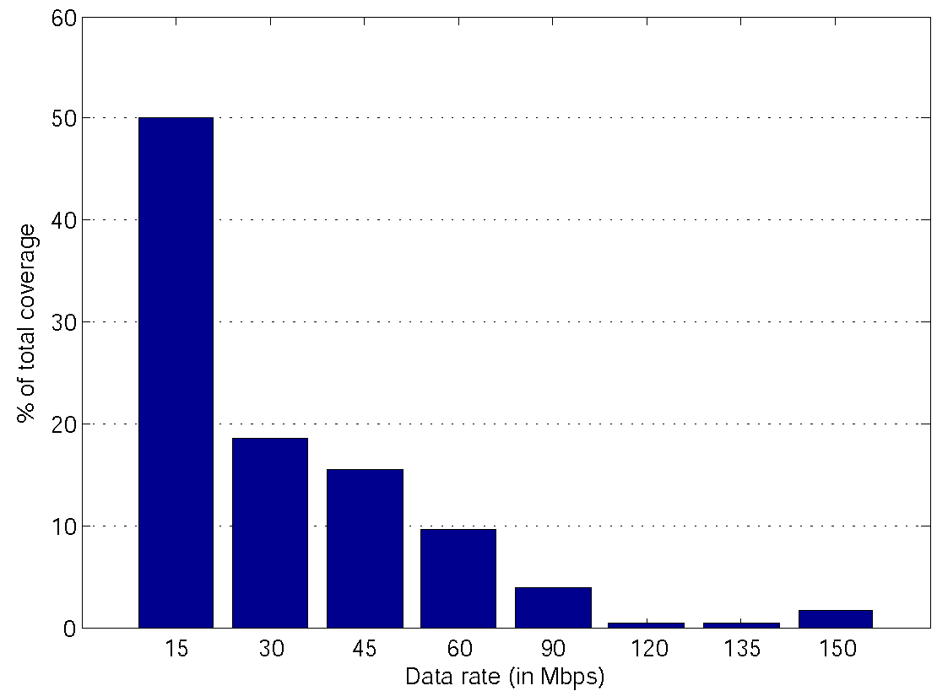
Percentage of total area as a function of the data rate

Slide 51
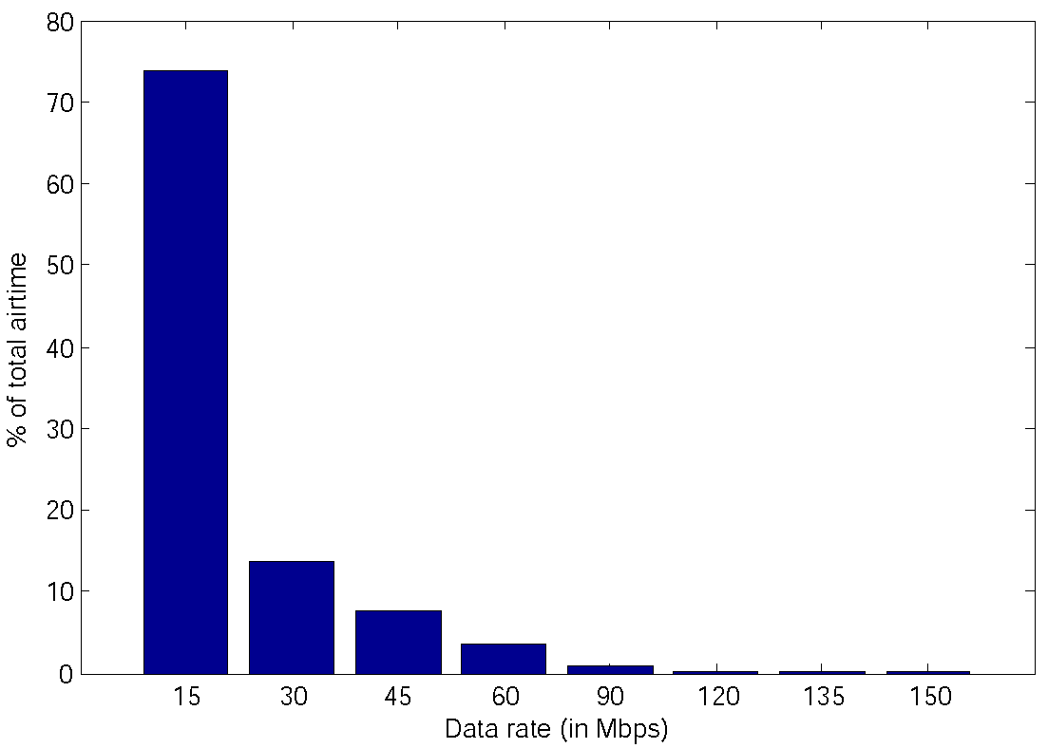
Percentage of airtime as a function of the data rate
Under the fairness assumption.

Slide 52
Solar Activity
Solar storm headed to Earth but few power grid problems expected.
- The Ottawa Citizen, July 13, 2012.
Massive blast of radiation from a huge solar flare headed for Earth. Solar radiation that NASA warns could temporarily disrupt satellite communications and power grids.
- The Calgary Herald, July 14, 2012.

Slide 53
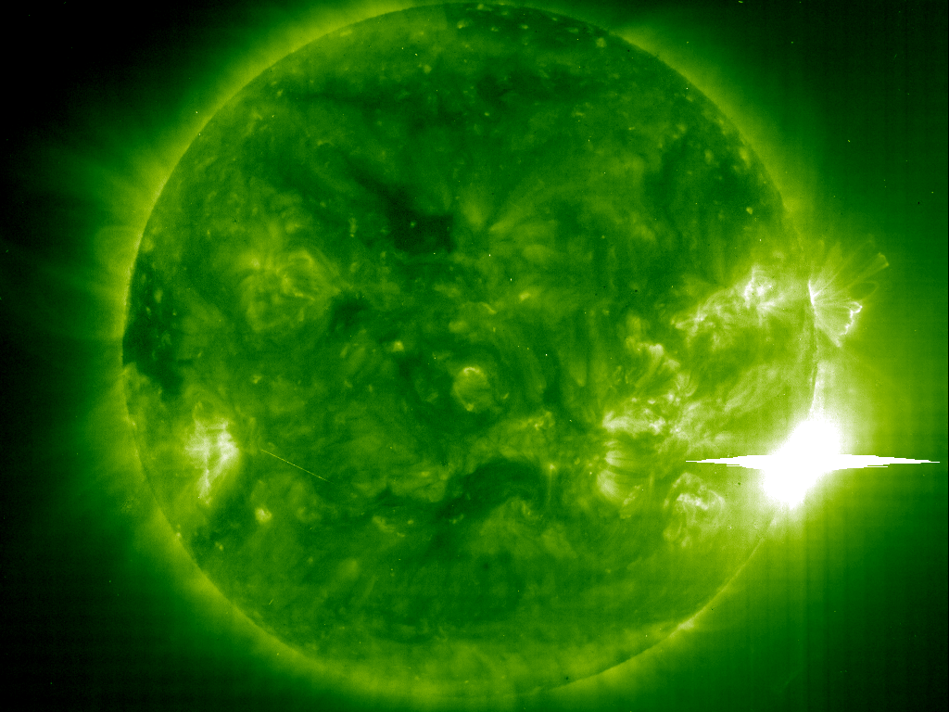
The big one.

Slide 54
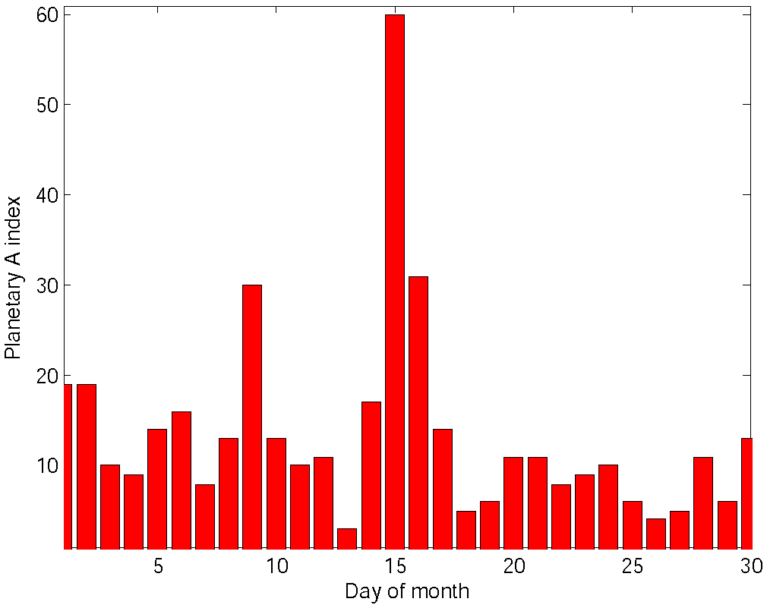
Planetary A index during the month of July 2012.

Slide 55
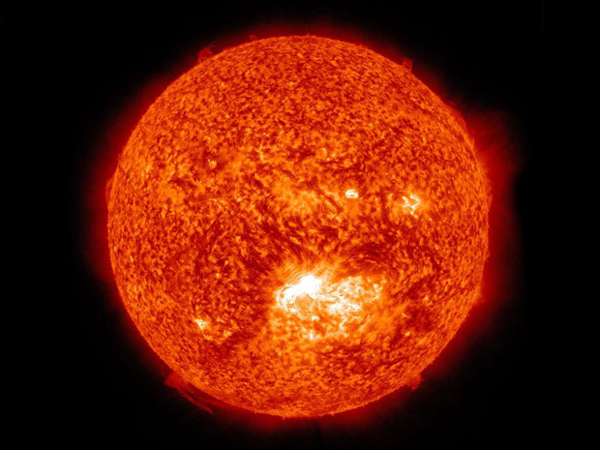
Coronal Mass Ejection of July 12, 2102

Slide 56
WIRELESS DIGITAL COMMUNICATIONS MYTHS

Slide 57
1. Digital communications is superior to wireless analog communications!
Current consumption, analog is better.
Digital modulation is more complex and needs more resources (circuitry or computational).

Slide 58
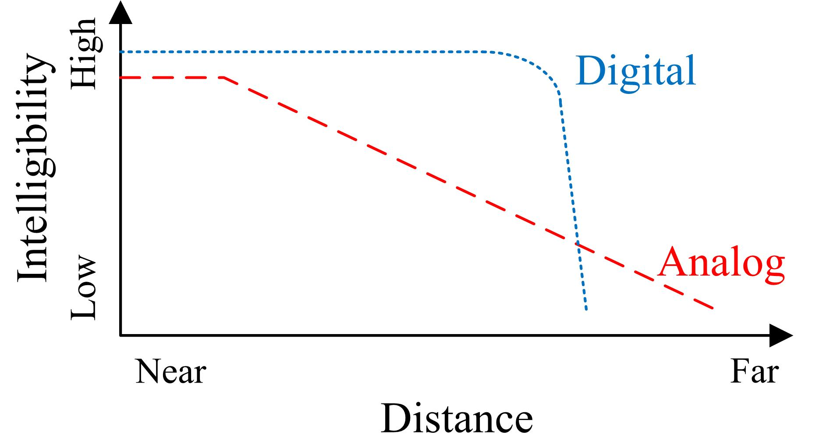
2. Digital voice is better than analog voice!

