Slide 1
Chapter 4 – Wireless Security

Slide 2
Wireless Communications Specific Threats

Slide 3
Key terms
Attack: A series of steps executed by a malicious individual aiming
  to access confidential data
  to disrupt the normal operation of a software, piece of equipment, system or network.
Attacker: An entity (e.g., an individual or a process) perpetrating an attack.
Threat: A hypothetical case in which an attacker exploits a weakness or a flaw to perpetrate an attack.

Slide 4
Wireless communications threats
Eavesdropping
Unauthorized transmission
  Jamming
  Denial of service
MAC layer misbehaviour
Address spoofing
Location tracking

Slide 5
Risk Analysis

Slide 6
Key terms
Risk: A possibility of the perpetration of an attack.
Risk assessment: Evaluation of the level of risk of an attack. According to
  potential impact
  technical difficulties that must be overcome
  motivation of potential attackers.
Quantitative risk assessment:
  Assignment of a numerical probability to a level of risk.
  Based on historical data (objective by nature).
Qualitative risk assessment :
  Assignment of a symbolic value (e.g., low, medium or high) to a level of risk.
  Relies on the expertise of the people conducting the analysis (subjective by nature).
Risk management: Includes
  risk assessment,
  communication of the risk to the users and
  plans for damage control in cases attacks are carried out with success.

Slide 7
Risk assessment: Why?
Wireless security literature has neglected risk assessment
  Example: Lack of perspective in the work on wireless malware propagation (issue raised by Zanero, IEEE Security and Privacy, 2009)
Achieve perspective in a predictable & methodological manner!
Deal with the potential of harmful consequences
Decide if a technology is worth using
Continuing process

Slide 8
Wireless Malware Outbreak
Malware running on a router can be used to intercept information
According to Zanero [2009], a malware outbreak in the wireless world is only theoretical and unlikely to occur in practice
  diﬃculty to write a malware for a wide diversity of hardware platforms
  at best a small fraction of the routers can be infected
  networks of routers being infected by malware would be substantially disrupted, attack would be quickly noticed by network
Unlikely to occur, risk is minor

Slide 9
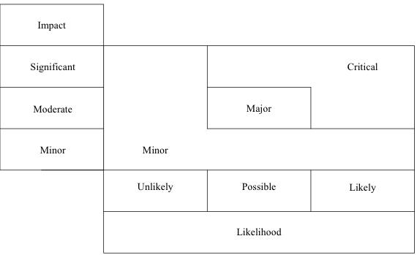
Risk as a function likelihood and impact, according to ETSI

Slide 10
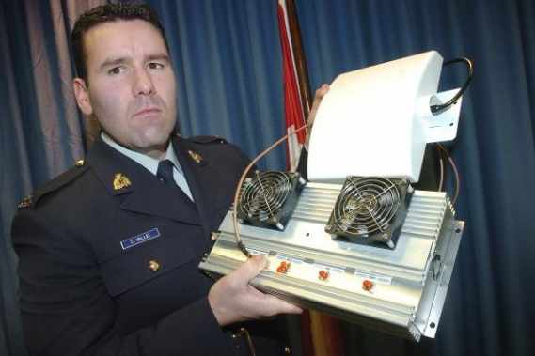
Impact assessment
Minor
February 2009 - Royal Canadian Mounted Police (RCMP) seizes 66 jammers of cellular phone, 911 and emergency service frequencies.
Annoyance or reversible consequences
Outages very limited in scope, few users impaired for a short duration

Slide 11

Impact assessment (cont’d)
Local residents dealing with open-and-shut case, sort of
July 2012
New radio system at sub base fouling up garage door openers. Sondra Tuchman used to open her garage door from halfway down the block. Now she has to get out of her car, stand in front of the door and press the remote.
A new radio system operating at the Naval Submarine Base in Groton may be to blame. The communications system is being used at most U.S. military installations to connect military personnel and civilian first responders over a wide area, and it "may interfere with nearby garage door openers in the surrounding community”.

Slide 12
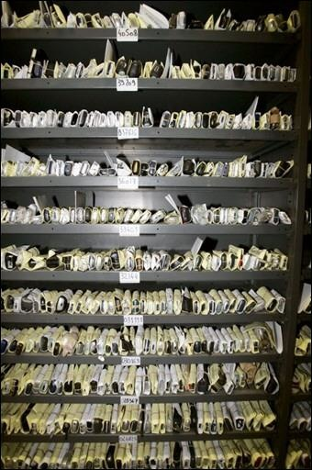
Impact assessment (cont’d)
Moderate
October 2006 – Woman arrested at her arrival at the Cairo International Airport pregnant with 48 cellular phones.
Short duration service loss
Outages that are limited in both scope and possible financial losses

Slide 13
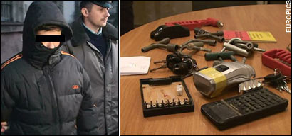
Impact assessment (cont’d)
Significant
Poland, Lodz 2008 - Schoolboy hacks into city's tram system. Adapted a television remote control so it could change track points. Twelve people were injured in one derailment, and the boy is suspected of having been involved in several similar incidents.
Service loss or outages over a long period of time with a large number of users impaired
Possibly accompanied by law violations or substantial financial losses

Slide 14

Impact assessment (cont’d)
Phony calls clog Des Moines police radio
December 2012
A Webster Township man programmed a radio to the Des Moines Police Department's communications frequency and used it to impersonate an officer while calling in nonexistent car crashes and fires, police said.
Kevin Grimes, 22, now faces 28 counts of obstructing emergency communications and eight counts of impersonating public officials.
The eight impersonation counts come from the multiple alleged calls that forced Des Moines public safety departments to send people, vehicles and equipment to the scene of supposed incidents. ...

Slide 15
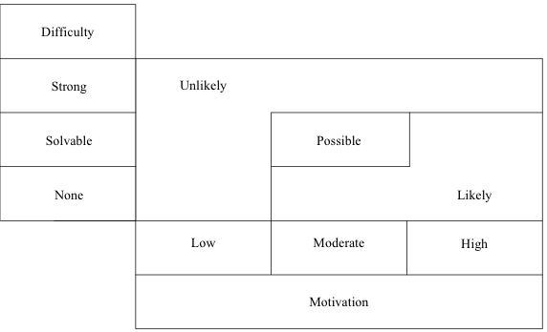
Likelihood as a function of attacker motivation and technical difficulty

Slide 16
Motivation assessment

Slide 17
Example: Canada's ranking for sensitive information
Subcategory | Motivation | Impact
Protected C (extremely sensitive) | High | Significant
Protected B (particularly sensitive )
Protected A (low-sensitive) | Moderate | Minor/Moderate

Slide 18
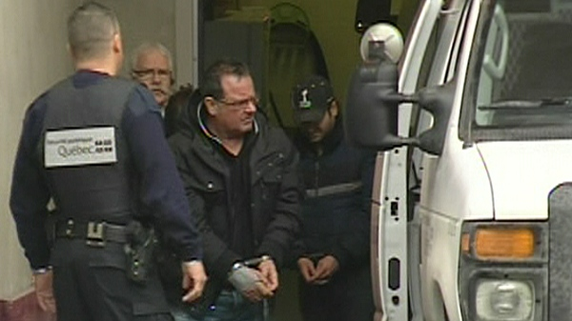
BlackBerry messages may be used in Mafia murder case
CTVNews.ca, Jan. 2012
Murder of Salvatore Montagna: Raynald Desjardins apprehended by police ..... Blackberry may have given up clues in Montagna murder ... The police have successfully intercepted PIN messages, encrypted messaging ...

Slide 19
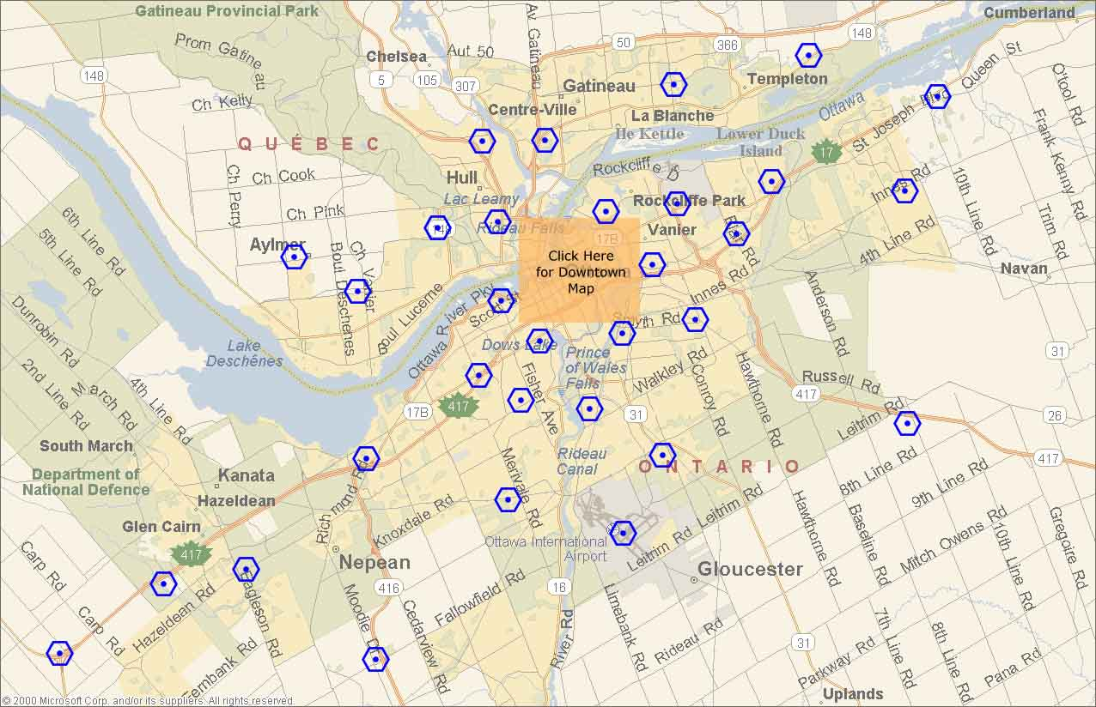
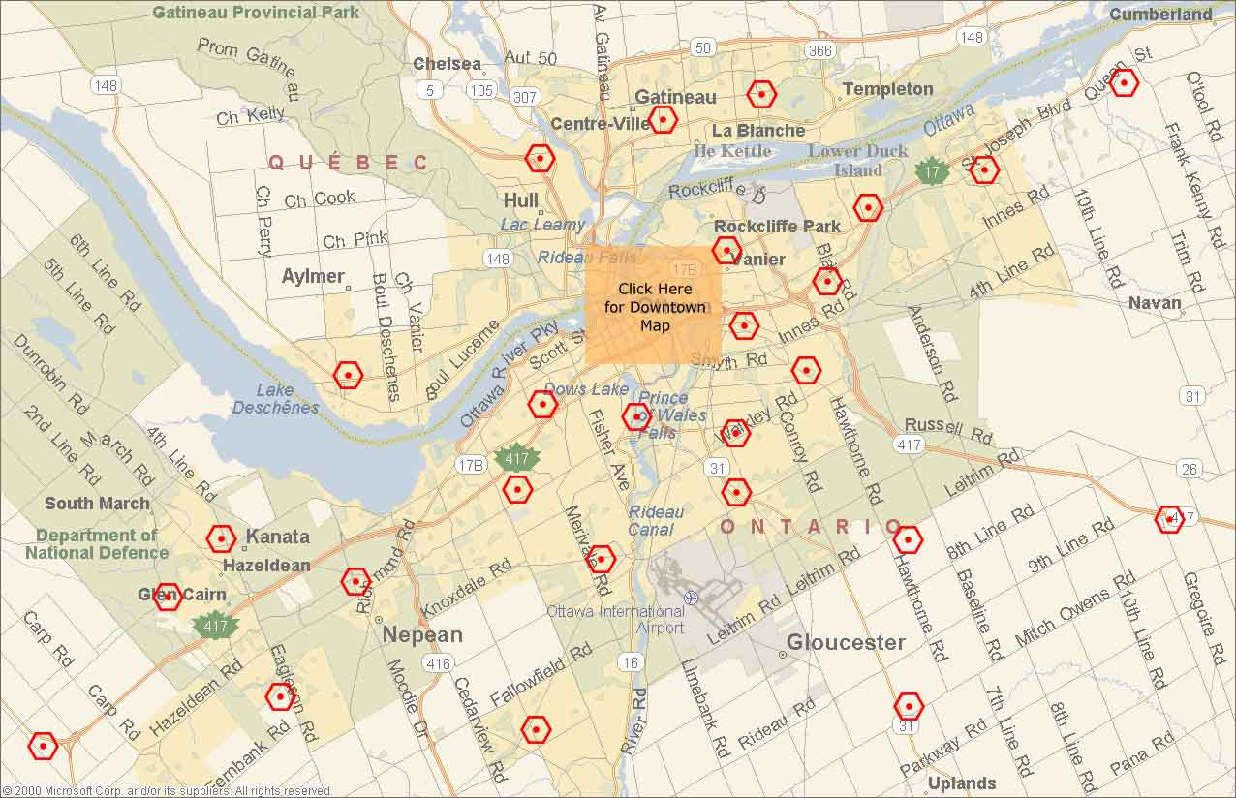
Eavesdropping Management Messages:
Mapping Cellular Networks

Slide 20
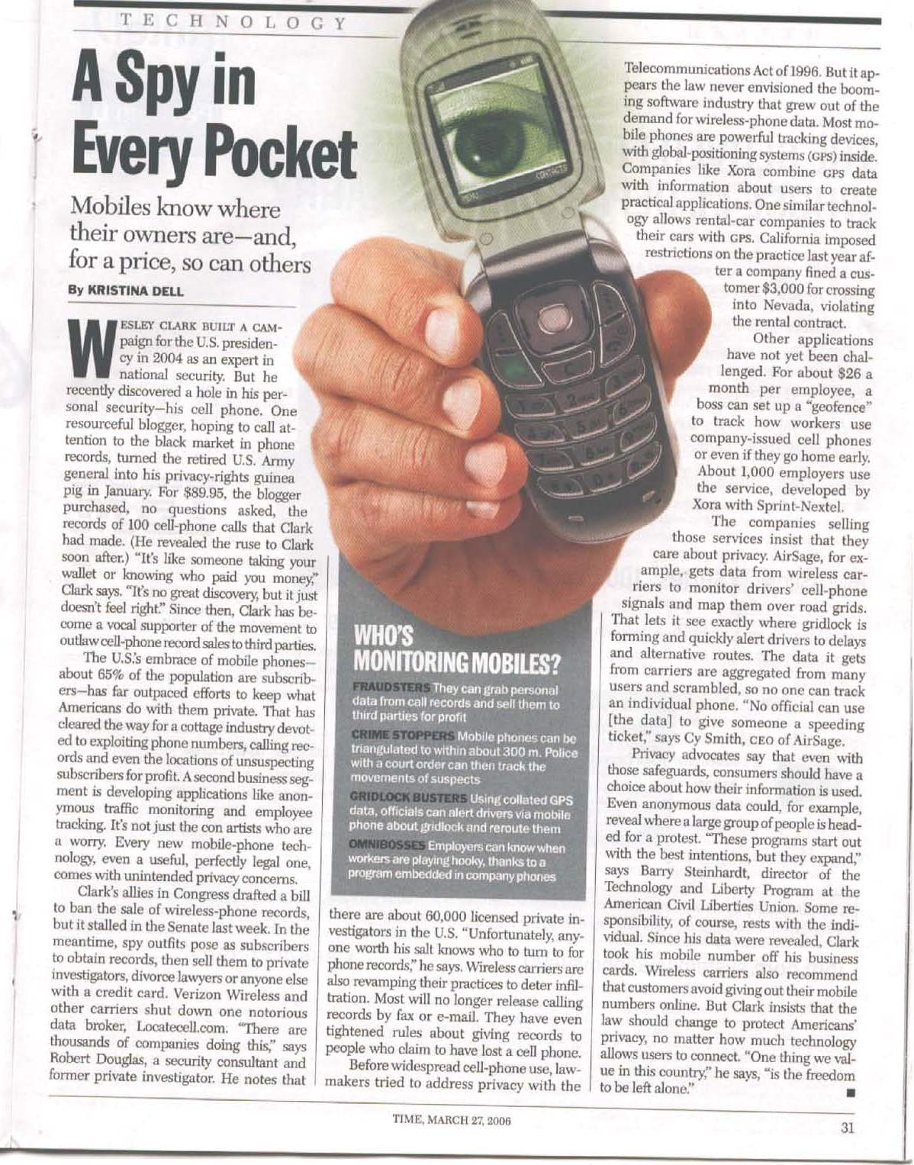

Result of Eavesdropping Management Messages: Location Tracking With Cellphones
BS 1
BS 2
Time Magazine, March 27, 2006
Notes:
This article tells a story in which a third party purchased of cell phone records of a subscriber.
The victim subscriber is Wesley Clark, who had been involved, in 2004, in the preparation of the campaign of the US president as a security expert.
The sale of cell-phone records to third parties is not illegal (2006).
The methods can be used for other kinds of attacks such as employee tracking (the omniboss concept) and car tracking by car-rental companies (to detect violations of rental contracts).

Slide 21
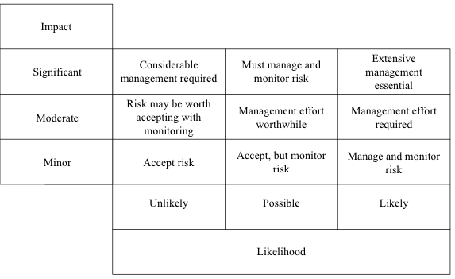
Risk management actions as a function of impact and likelihood

Slide 22
Confidentiality

Slide 23
What is Confidentiality?
The content of a message can be understood only by its source and destination

Slide 24
Why is it Challenging?
Interception easiness
Need to maintain backward compatibility
Easiness to work around regulations

Slide 25
Interception of traffic HOWTO
Application level
  Monitoring or scanning software (e.g., Kismet)
Frame level
  Linux Packet Socket API
Signal level
  Software-Deﬁned Radio (SDR)
  Documented work: Implantable Medical Device, GSM, BlueSniff, RFdump (802.11, Bluetooth and ZigBee)

Slide 26
ENCRYPTIOn

Slide 27
Encryption
Stream cypher
  RC4/WEP
  TKIP
Block-cypher
  AES
  DES
Quantum encryption

Slide 28
Stream cypher

Slide 29
RC4 Encryption

Slide 30
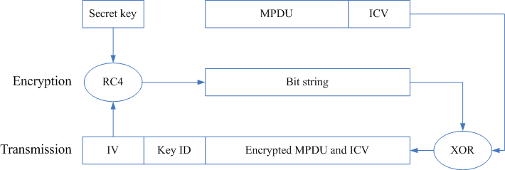
WEP Encryption
Notes:
The RC4 Stream Cipher of WEP
The Initialization Vector (IV) is a 24-bit random value chosen by the sender independently for each MPDU. It is like each MPDU has its own new stream!
A default key is a 40- or 104-bit key shared between an AP and several stations.
A key-mapping key a is 40- or 104-bit key shared between an AP and one station.
Use of a 24-bit IV and a 40-bit key is called 64-bit security. Use of a 24-bit IV and a 104-bit key is called 128-bit security. All MPDUs are encrypted with the same key.
Data is encrypted by RC4 using an IV and a default key or a key-mapping key (secret symmetric key).
The Integrity Check Value (ICV) is a mechanism to verify if frames are intact. CRC-32 is used for that purpose. It is not a security mechanism, but an error detection technique!
A great advantage of WEP/RC4 is the ease of implementation (does not use complex operations to implement). It is done in the wireless interface hardware.
30

Slide 31
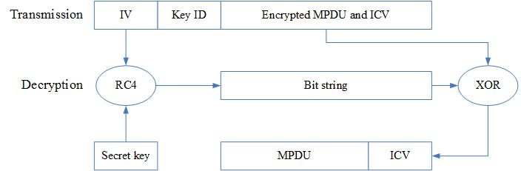
WEP Decryption
Notes:
RC4 is a symmetric algorithm. Decryption is the reverse of encryption. Same IV and default key or key-mapping key are used.
31

Slide 32
Cracking RC4 Messages
Notes:
Obtaining MPDUs Encrypted with Same Key stream
1) Reuse of IV Values
A 24-bit IV field means that there are 2 power 24 (almost 17 million different IV values).
At 11 Mbps, 1kB frame size, 1,343 MPDUs are transmitted per second over the network.
Frame size 1024 bytes/frame * 8 bits/byte = 8,192 bits/frame
Frame rate 11 Mbps / 8,192 bits/frame =11*10^6 bps / 8,192 bits/frame = 1,343 frames/second
It takes less than 4 hours to use all possible IV values.
17*10^6 IV values / 1,343 frames/second = 12,658 seconds
12,656 seconds / 3600 seconds/hour = 3.5 hours
Collection of several MPDUs encrypted with the same IV is done quickly.
IV values are reused by individual stations and across stations (there is nothing unique to each station entering in the formation of the RC4 seed).
2) ARP Packets Collection
Address Resolution Protocol (ARP) packets can collected to obtain MPDUs encrypted with the same keys stream. They are of a fixed format. The XOR of an encrypted ARP packet with an ARP packet template reveals parts of the key stream, and also a small part of the secret key. Less than 85,000 iterations (less than 60 seconds) lead to the secret key [Tews, Weinmann, Pyshkin 2008].

Slide 33
Key Distribution
Default key
  40 or 104 bit symmetric network key
Key-mapping key
  40 or 104 bit symmetric pairwise key
IV (24 bits) + key (40 or 104 bits)=64 or 128-bit security

Slide 34
Wired Equivalent Privacy (WEP)
Cracking tools and software readily available
  IV too short
Well established that WEP is insecure: high risk of eavesdropping
Not an option for Protected B or C traffic

Slide 35
Temporal Key Integrity Protocol (TKIP/WPA)
RC4 encryption with longer keys

Slide 36
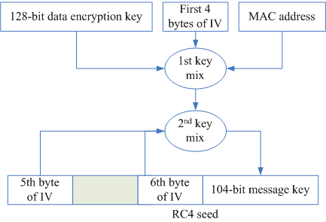
TKIP
Notes:
Temporal Key Integrity Protocol (TKIP)
New IV format! 32 more bits are added to the 24 bits already allocated to WEP, for a total of 56 bits (seven bytes). Effectively, only the first six IV bytes are used (one byte is ignored for weak key avoidance).
A mixing function combines the encryption key, IV and MAC address to create the RC4 seed. The use of the MAC address as an input avoids the use of identical seeds across stations.
Packet numbering, in sequence, is used for replay protection.
There is a 64-bit integrity check value, based on the MICHAEL (Message Integrity Code) technique. MICHAEL uses solely shift and add operations.
Deprecated in 802.11m (802.11 cleanup).
Threat: Brute Force
Attack
Capture frames (get nonces entering in the calculation of the key) during the 4-way handshake for key establishment (e.g., use program airodum-ng). Re-keying can be forced using a deauthentication attack.
Use brute force to find the encryption key (e.g., using program cowpatty), i.e. try all possibilities. Can be very slow, i.e. take years!
36

Slide 37
Attacks
Brute force attack acceleration [Moen et al. ‘04]
  Theoretically possible to resolve the 128-bit temporal key from TKIP RC4 encrypted frames
  Time complexity: O(2¹⁰⁵)
Chopchop attack [Beck and Tews ’09]
  Decrypt the content of an ARP packet, byte by byte
  Access points do implement mitigation mechanisms slowing down the attack
Beck-Tews attack
  extension of the chopchop attack
Royal Holloway attack
  theoretical attack exploiting RC4 vulnerabilities
Likely that a general eavesdropping attack on TKIP will eventually succeed
Risk is critical, i.e., need to monitor the TKIP cracking progress

Slide 38
Block-cypher

Slide 39
CCMP/WPA2
Advanced Encryption Standard (AES)
128-bit keys
Counter Mode with Cipher Block Chaining Message Authentication Code Protocol (CCMP)/802.11i
Message Integrity Code (MIC)
  MPDU, including header (contains a nonce)
Nonce
  Packet number (48 bits), MAC address (48 bits), priority (8 bits)

Slide 40
Counter Mode
Notes:
Counter Mode
The counter mode, of AES, was created specifically for 802.11i.
It is used in combination with cipher block chaining (CBC) to generate the message integrity code (MIC). The MIC applies to the entire MPDU, including the header. For replay protection purposes, the header includes a nonce. The nonce consists of a packet number (48 bits), MAC address (48 bits) and priority field (8 bits), for a total of 104 bits. The MIC is computed before encryption. The data part together with the MIC are encrypted.
Successive 128-bit keystreams are obtained by encrypting the combination of the key, IV and counter. The nonce of the MIC is used for the counter (of fragments of a packet) together with a 8-bit flag value and 16-bit counter, for a total of 128 bits.
Threat: brute force attack!
Source:
Counter with CBC-MAC (CCM), Request for Comments: 3610, September 2003.
40

Slide 41
Attacks
Brute force attack and dictionary attack
  can be prevented with good passphrase management
Eavesdropping attack
  diﬃculty is strong, unlikely, risk is minor

Slide 42
QUANTUM Encryption

Slide 43
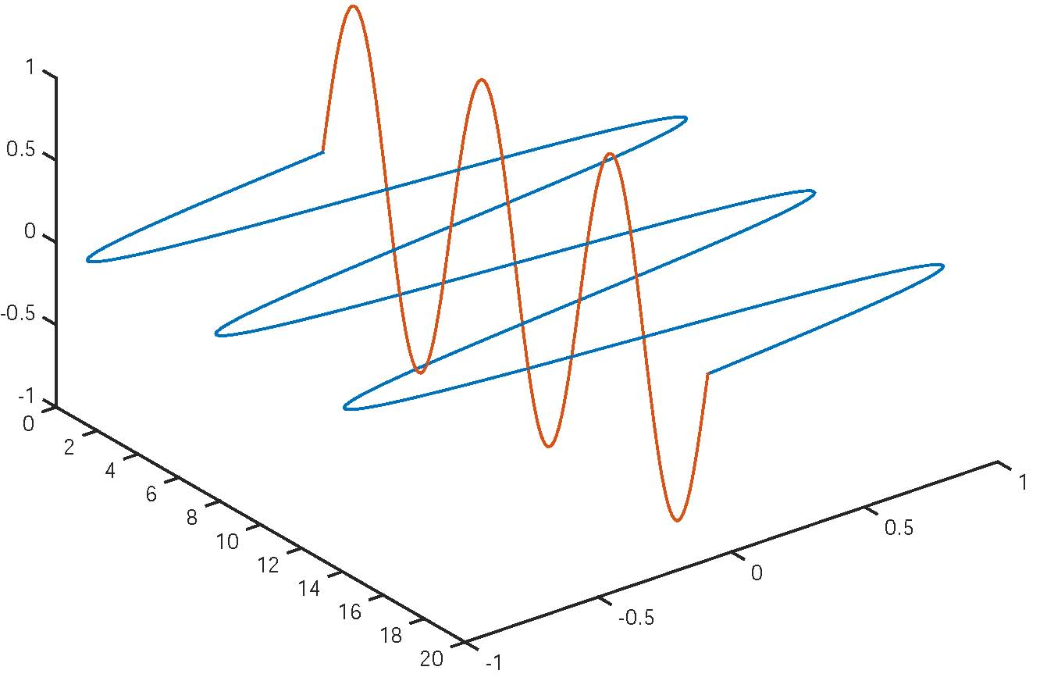
Polarization of Photons

Slide 44
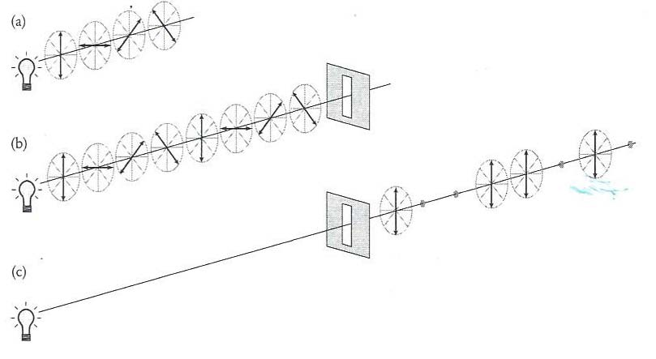
Polaroid filter

Slide 45
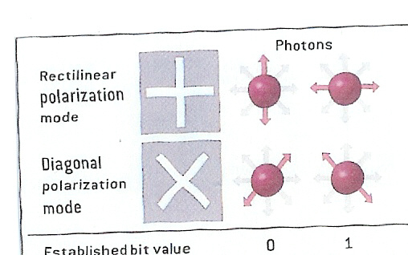
Encoding Information in photons

Slide 46

Rectification of polarity

Slide 47
Orthogonal vs non-orthogonal polarity
Let us assumed that a rectilinear filter is used to filter a beam of photons.
All rectilinear polarized photons pass through the filter.
Diagonally polarized photons go through as well, but their basis is rectified.
The polarity of every diagonally photon is rectified vertically, with probability 50%, horizontally, with probability 50%.
The rectilinear and diagonal basis are not mutually orthogonal.
Although, vertical and horizontal polarities are mutually orthogonal because there are no possible rectification from one to the other.

Slide 48
Non-cloning theorem
Assuming polarities are not mutually orthogonal.
A photon polarity (quantum state) is disturbed during measurement.
It is impossible to make copies of photons in unknown polarities.
An arbitrary photon polarity cannot be perfectly duplicated.

Slide 49
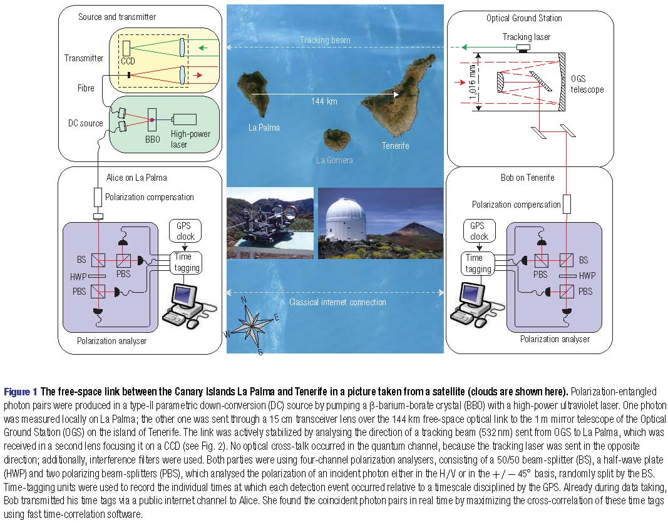
Free space quantum communication
R. Ursin et al., Entanglement-based quantum communication over 144 km. Nature Physics, 3(7):481--486, 2007.

Slide 50
Quantum Key Distribution (QKP)
Aka: BB84 (Bennet and Brassard 1984), quantum key expansion protocol
Two parties (Alice & Bob)
  Insecure photon (quantum) channel
  Authenticated classical channel
  Share a short key
  Can generate random numbers
One adversary (Eve)
  Can intercept & resend photons
  Can eavesdrop, but not alter classical channel

Slide 51
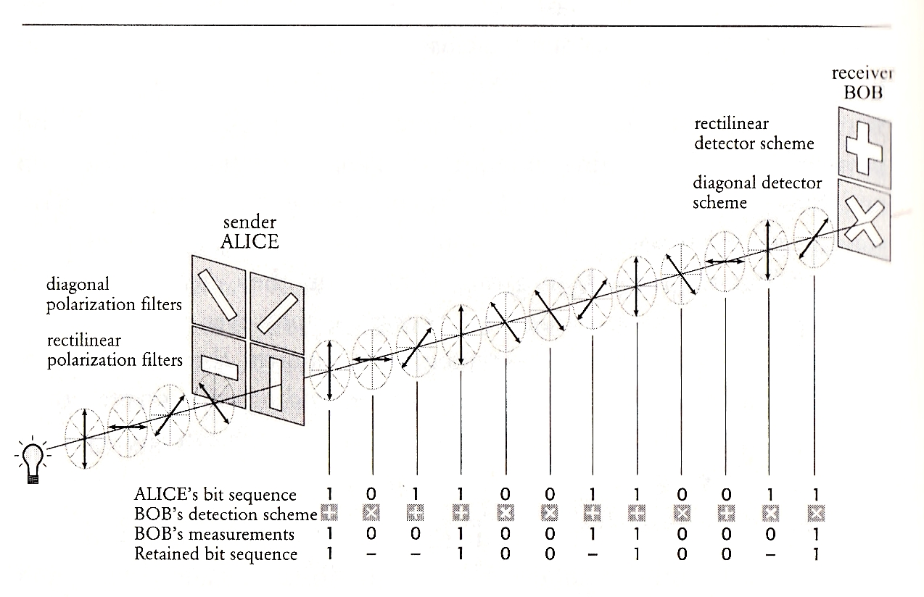
QKP

Slide 52
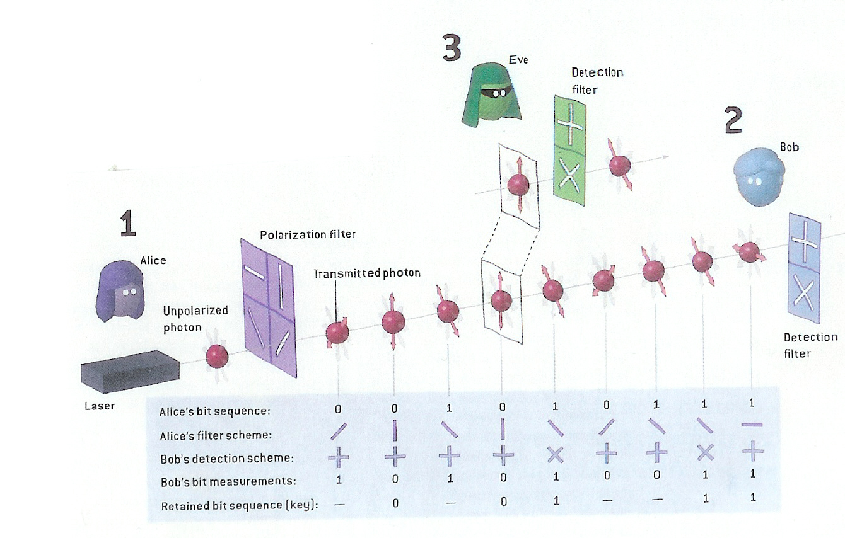

Slide 53
Authentication

Slide 54
WEP Device Level Authentication
Notes:
With WEP device level authentication, the station must provide to the AP a proof of ownership of the key.
Four messages are exchanged.
The station request.
The AP sends a challenge, i.e. a 128-bit random value.
The station sends a response, i.e. the 128-bit random value encrypted with the RC4 cipher stream.
The AP decrypts the response. If the decrypted response matches the original challenge value, then an authenticate response is sent to the station.
Limitations:
Authentication is one-way, i.e. the AP is not authenticated by the station.
After the completion of the authentication phase, subsequent traffic is not authenticated.
Authentication spoofing [Arbaugh et al. 2001; Borisov et all, 2001]: The key stream is derived by XORing the challenge value with the response. The key stream is used by the attacker to create proper responses to new challenges.

Slide 55
Port-based model

Slide 56
Keys
Pre-Shared KEY (PSK)
Pairwise Master Key (PMK): Long term
Pairwise Transient Key PTK)
  Temporal Key (TK): Traffic
  Downlink MICHAEL MIC Key
  Uplink MICHAEL MIC Key
  Group Temporal Key (GTK)

Slide 57
WPA Authentication

