Slide 1
Chapter 5 – Mobility Support

Slide 2
Why mobility support?
Session continuity
Localization

Slide 3
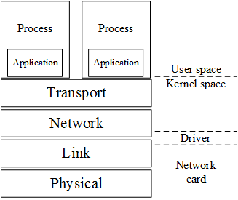
Network architecture

Slide 4
Review of IPv4

Slide 5
Three classes of IPv4 addresses

Slide 6
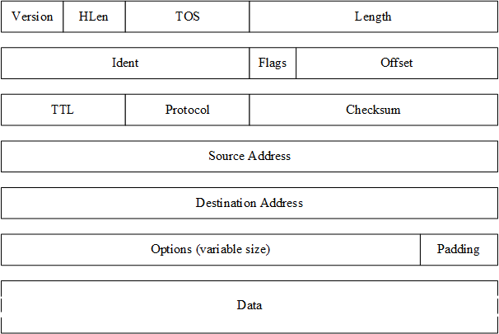
IPv4 packet header

Slide 7
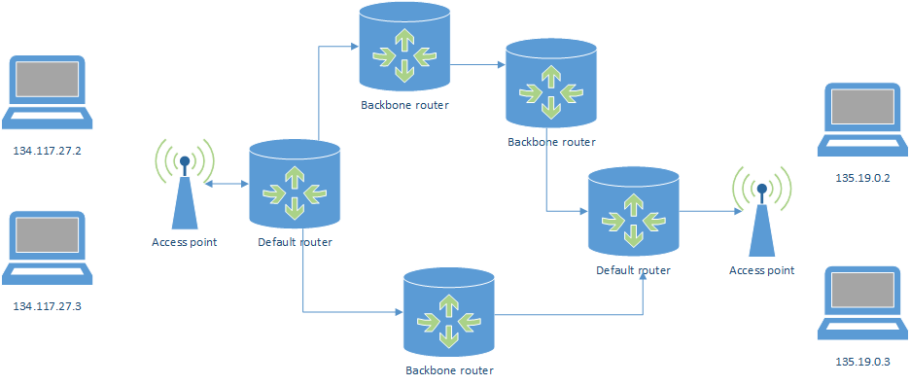
IPv4 routing

Slide 8
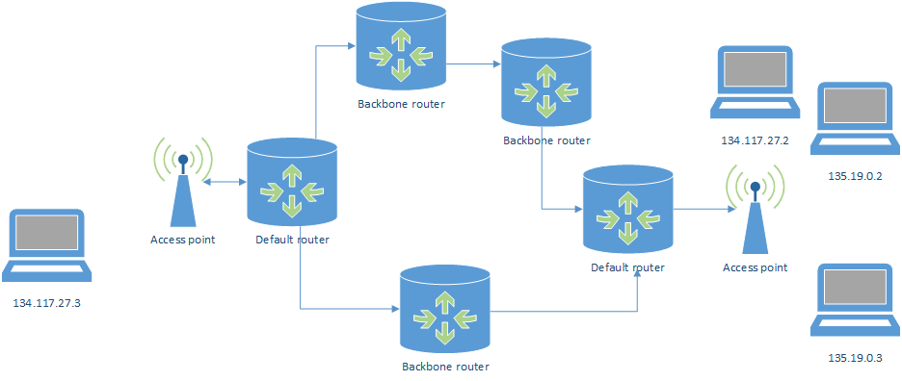
IPv4 routing with mobility

Slide 9
Applications vs mobility
Short-lived
Short duration TCP connections
Example: Web client
Long-lived
Long duration TCP connections
Example: IP telephony

Slide 10
