Slide 1
Chapter 9 - Underwater Sensor Networks

Slide 2
Applications
monitoring of the undersea environment
pollution reduction and control
physical intrusion detection

Slide 3
Underwarter Acoustic Waves
Acoustic pressure, acoustic intensity and acoustic power

Slide 4
Wave pulse (disturbance travels, not individual medium particles)

Slide 5
Acoustic pressure field produced by a monopole source
Source: http://www.acs.psu.edu/drussell/demos.html

Slide 6
Hydrophone

Slide 7
Frequency range of underwater acoustic activities (in kilohertz)

Slide 8
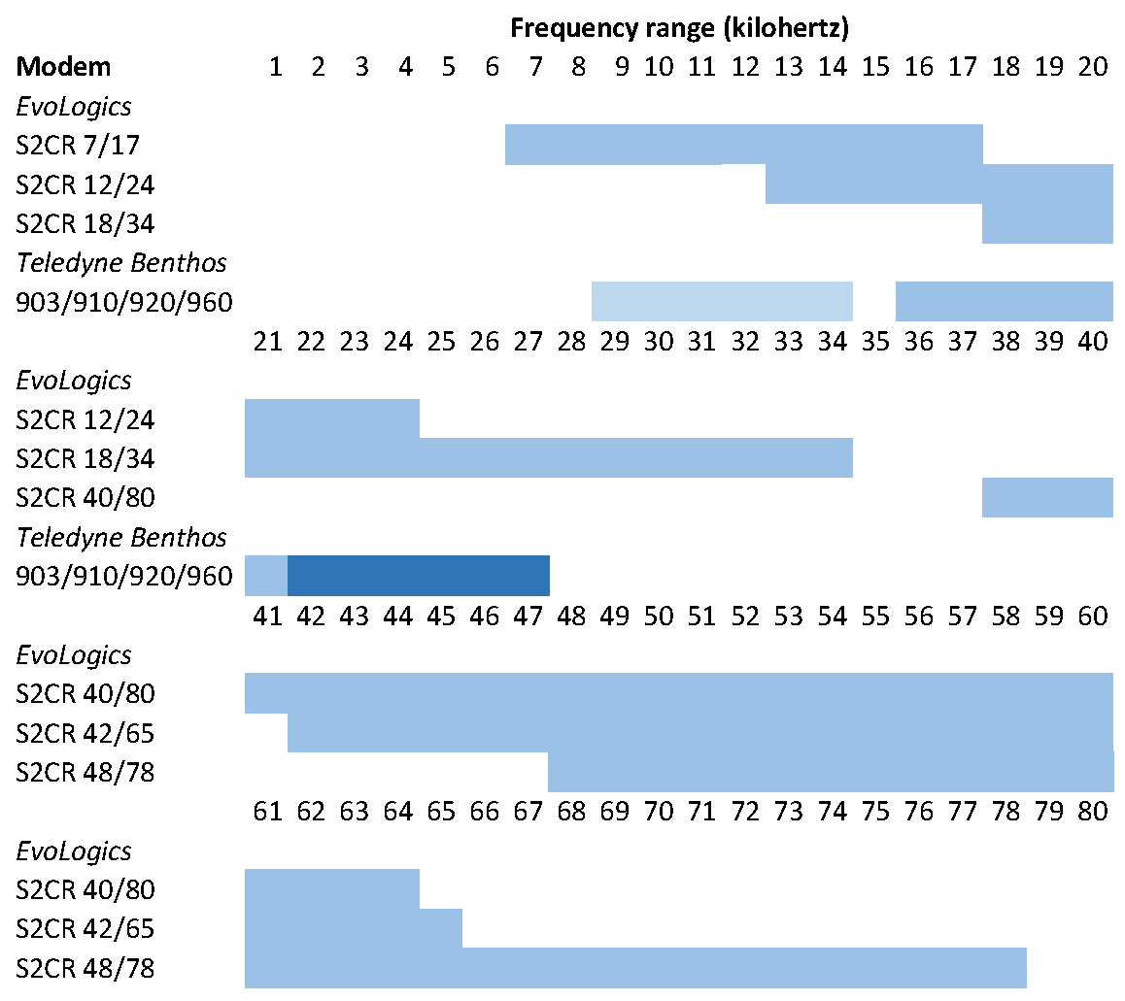
Frequency range of modems

Slide 9
Underwater Communication Impairments
Absorption, geometric spreading, multipath propagation and noise

Slide 10
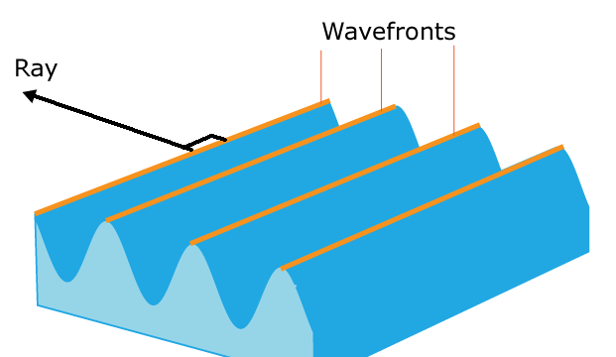
Wavefront

Slide 11
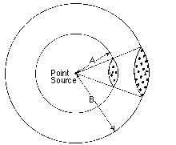
Geometric spreading

Slide 12
No refraction
Wave propagates in a medium where the speed is constant in all directions. Wave expands outwards as an expanding circle, traveling at the same speed in all directions. Since the wave speed is the same everywhere, there is no refraction, and the wave does not change direction.

Slide 13
Refraction

Slide 14
Refraction
Propagation in a medium where the speed in the x-direction is constant, but where the speed in the vertical y-direction decreases with height
(c = 1 - 0.05y)
As a result the wave changes direction and bends upwards.
Propagation in a medium where the speed in the x-direction is constant, but where the speed in the vertical y-direction increases with height
(c = 1 + 0.05y)
As a result the wave changes direction and bends downwards.

Slide 15
Multipath Propagation
Reflection, refraction

Slide 16
Reflection (iso speed)

Slide 17
Refraction

Slide 18
Sound speed profile

Slide 19
Reflected and refracted rays

Slide 20
Attenuation

Slide 21
Attenuation vs distance and frequency

Slide 22
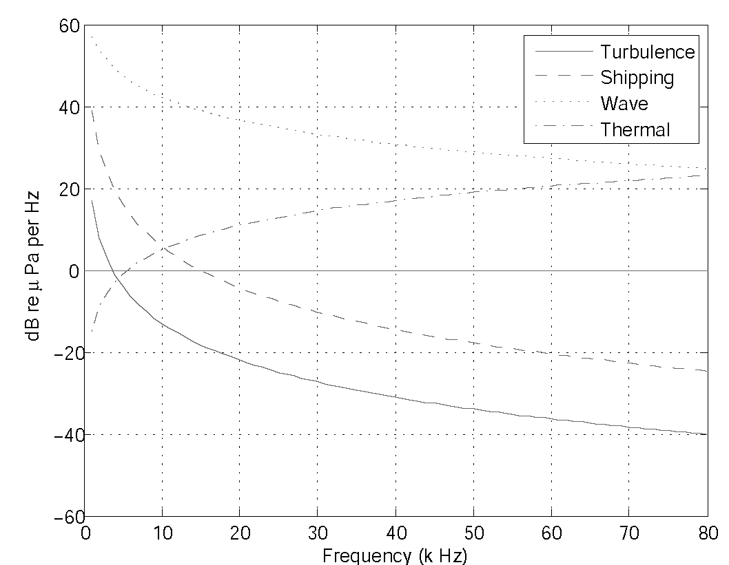
Noise

