Slide 1
Prior Knowledge for Part Correspondence
Oliver van Kaick¹, Andrea Tagliasacchi¹, Oana Sidi²,
Hao Zhang¹, Daniel Cohen-Or², Lior Wolf², Ghassan Hamarneh¹
¹Simon Fraser University, Canada
²Tel Aviv University, Israel

Slide 2
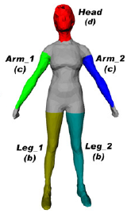
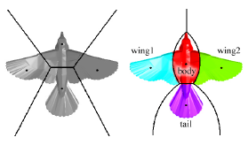
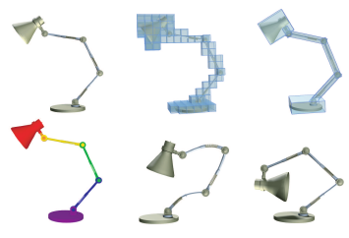
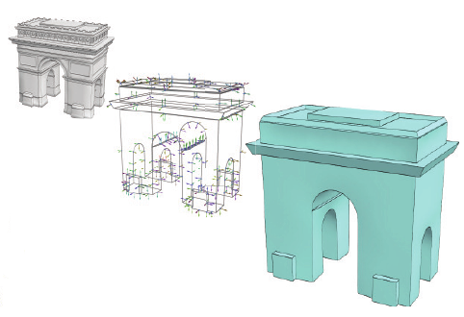
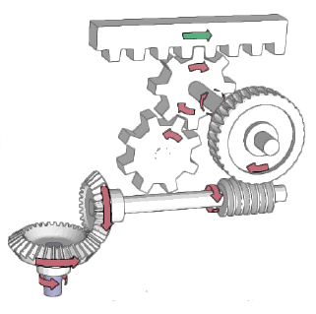
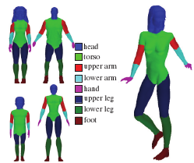
Semantic-level processing
Understanding shapes
Attene et al. CG 2006
Multi-objective optimization
Simari et al. SGP 2009
Joint-aware manipulation
Xu et al. SIGGRAPH 2009
Learning segmentation
Kalogerakis et al. SIG 2010
Abstraction of shapes
Mehra et al. SIGAsia 2009
Illustrating assemblies
Mitra et al. SIG 2010
Notes:
Recently, there has been a trend to do geometry processing at a higher level, particularly extracting semantic information.

Slide 3
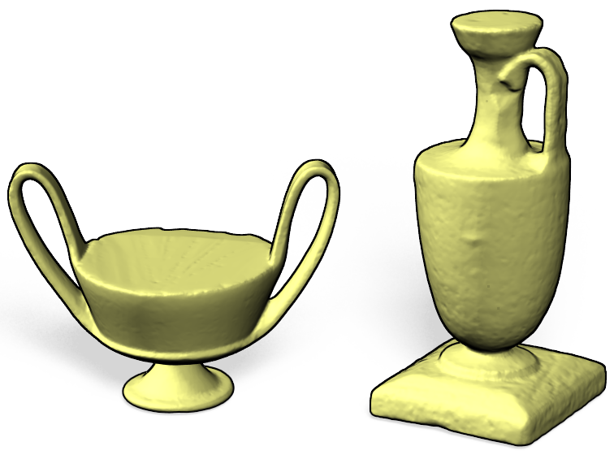
Shape correspondence
Understand the shapes → Relate their elements/parts
Notes:
Shape correspondence is a classic problem which also falls into this category: it requires an understanding of the shapes semantics. Explain shape correspondence.

Slide 4
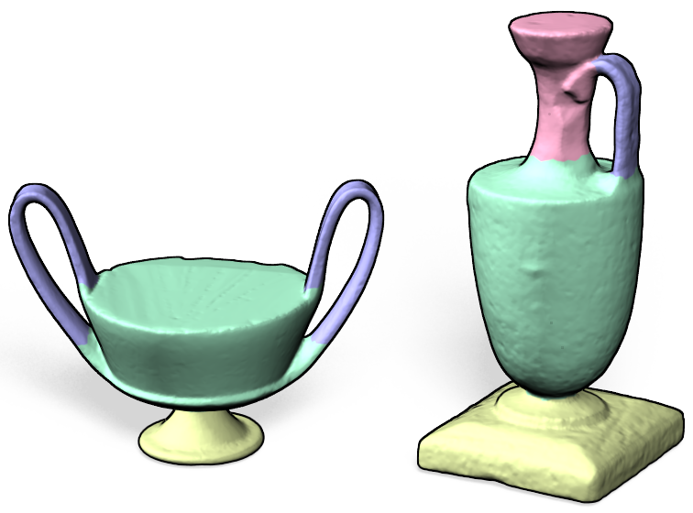
Shape correspondence
Understand the shapes → Relate their elements/parts
Notes:
Shape correspondence is a classic problem which also falls into this category: it requires an understanding of the shapes semantics. Explain shape correspondence.

Slide 5
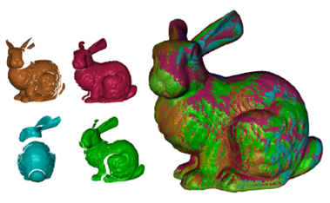
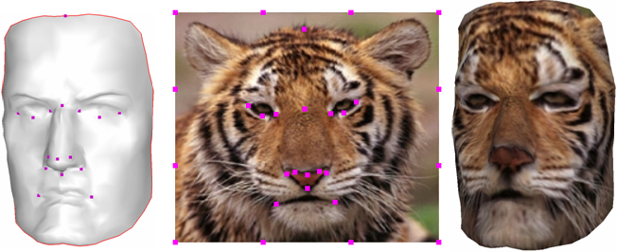
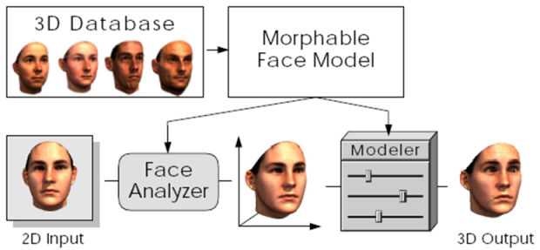
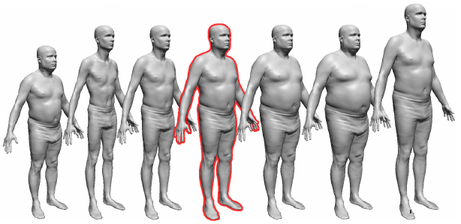
Applications of shape correspondence
Registration
Gelfand et al. SGP 2005
Texture mapping
Kraevoy et al. SIG 2003
Morphable faces
Blanz et al. SIG 1999
Body modeling
Allen et al. SIG 2003
Deformation transfer – Attribute transfer
Sumner et al. SIG 2004
Notes:
And it has many applications.

Slide 6
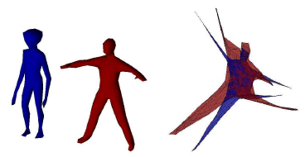
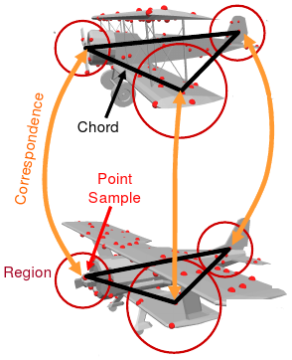
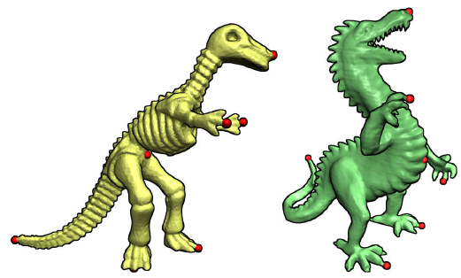
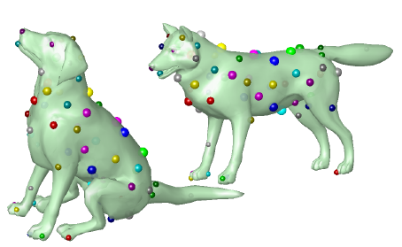
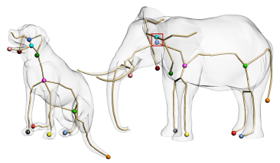
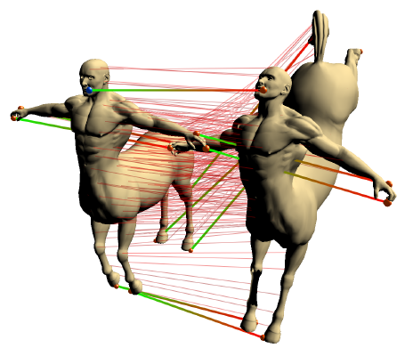
Content-driven shape correspondence
Spectral correspondence
Jain et al. IJSM 2007
Priority-driven search
Funkhouser et al. SGP 2006
Deformation-driven
Zhang et al. SGP 2008
Möbius voting
Lipman et al. SIG 2009
Electors voting
Au et al. EG 2010
Landmark sampling
Tevs et al. EG 2011
Notes:
Traditionally, methods have concentrated on directly comparing the geometry and structure (content) of the shapes. Explain content-driven correspondence.

Slide 7
Content-driven shape correspondence
Shapes with significant variability in geometry and topology
Geometrical and structural similarities can be violated
Notes:
These content-driven methods are all great work, but they are based on one assumption: the shapes possess enough similarity. However, there are cases that are challenging for these methods, e.g., explain the example above.

Slide 8
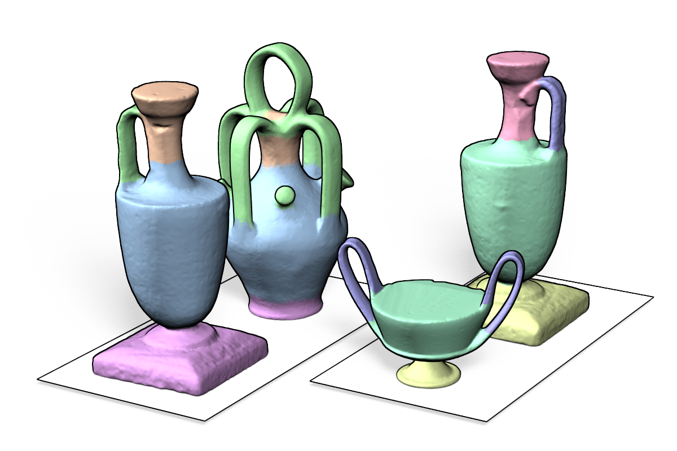
This paper
Perform a semantic analysis of the shapes
By using prior knowledge and content
Notes:
In such cases, shape correspondence has to be solved at the semantic level. In this paper, we propose to do exactly that by means of prior knowledge.

Slide 9
Learning 3D segmentation and labeling
Kalogerakis et al. [2010]: first mesh segmentation and labeling approach based on prior knowledge
Our approach shares similarities with their work

Slide 10
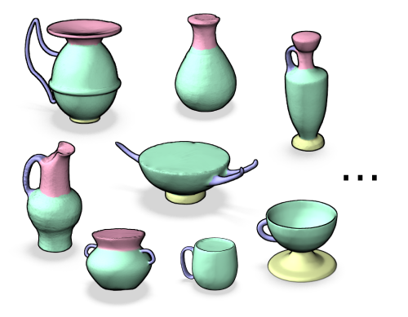
Prior knowledge
Dataset of segmented, labeled shapes
Semantic part labels → Part correspondence
Notes:
We learn semantic parts from the prior knowledge. Explain how the prior knowledge is represented. This implies that we obtain a part correspondence.

Slide 11
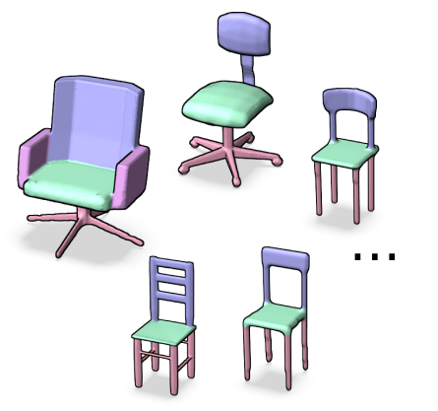
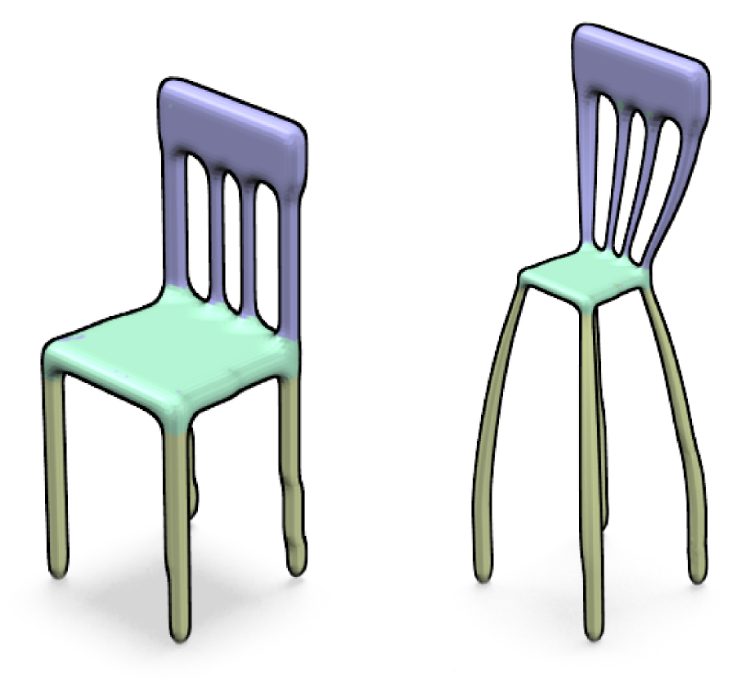
Content-analysis
?
Prior knowledge may be incomplete
Combine with content-analysis: joint labeling
Notes:
However, there are cases when the prior knowledge might not be sufficient. To deal with such cases we combine the knowledge-driven approach with content-analysis through a joint labeling scheme. This is derived from feature pairings between the two query shapes.

Slide 12
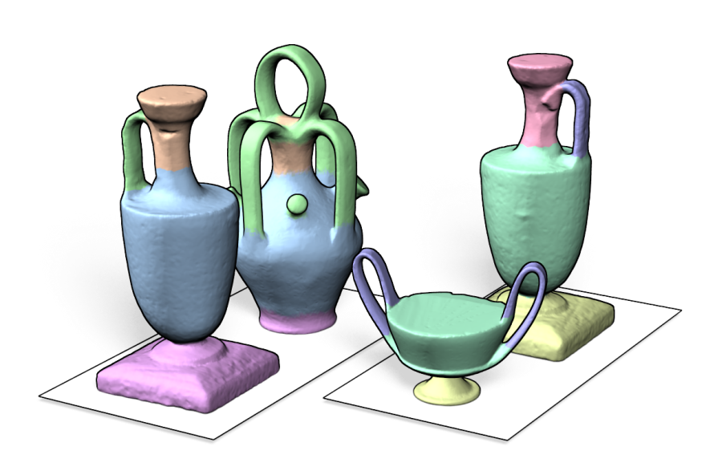
Contributions
Prior knowledge is effective
Content-analysis complements the knowledge
Notes:
So, summarize our contributions: prior knowledge + content analysis.

Slide 13
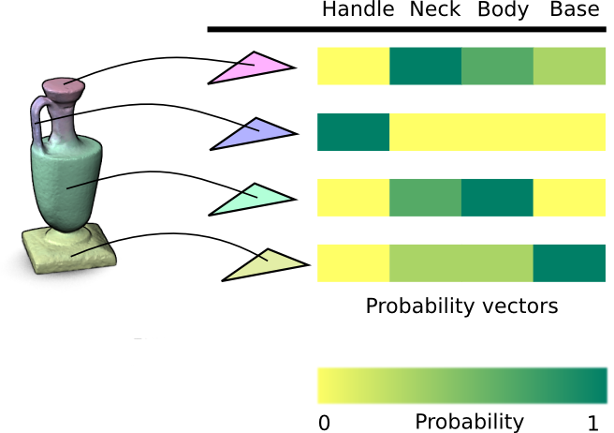
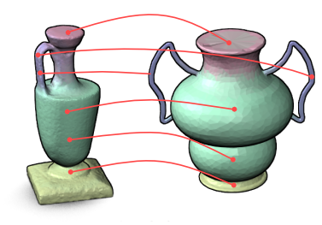
Overview of the method
1. Probabilistic semantic labeling
2. Joint labeling
Prior knowledge
Content
Notes:
Overview of the two steps of the method and what each steps adds to the method.

Slide 14
1. Probabilistic semantic labeling
Body
Handle
Neck
Base
Manually segmented, labeled shapes
First step: Prepare the prior knowledge
Notes:
First step explained in detail. Given the dataset of segmented, labeled shapes, we first need to prepare the knowledge.

Slide 15
1. Probabilistic semantic labeling
Body
Handle
Neck
Base
Compute shape descriptors for faces: geodesic shape context, curvature, SDF, PCA of a fixed neighborhood, etc.
Train a classifier for each label (gentleBoost [FHT00,KHS10])
Notes:
For that, we compute shape descriptors for the faces, for example, geodesic shape context, etc. Next, we take all the faces with the same label and use them to train a classifier. We use the gentleBoost training method, which has several advantages.

Slide 16
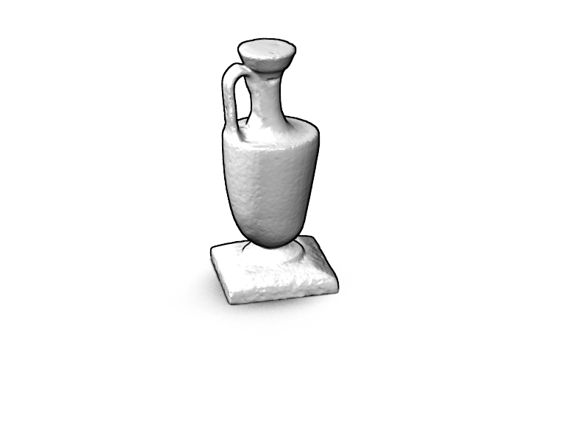
1. Probabilistic semantic labeling
Given the query pair
Label each query shape with the classifiers
Notes:
Now, given query shapes, we compute the same descriptors for the faces. Next, we label the faces with the classifiers.

Slide 17
1. Probabilistic semantic labeling
Output: probabilities per face
Notes:
The output are label probabilities for each face. They indicate what is the probability of each face being of a certain semantic part.

Slide 18
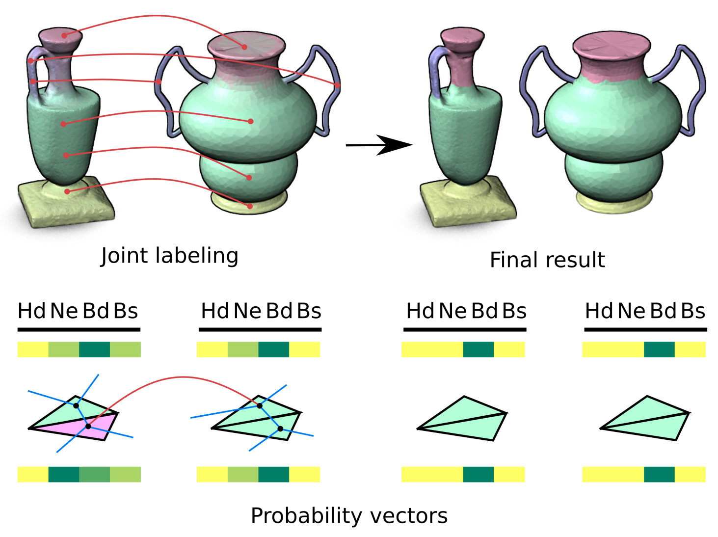
2. Joint labeling
Notes:
Second step explained in detail. Next, we combine the probabilistic semantic labels with content analysis.

Slide 19
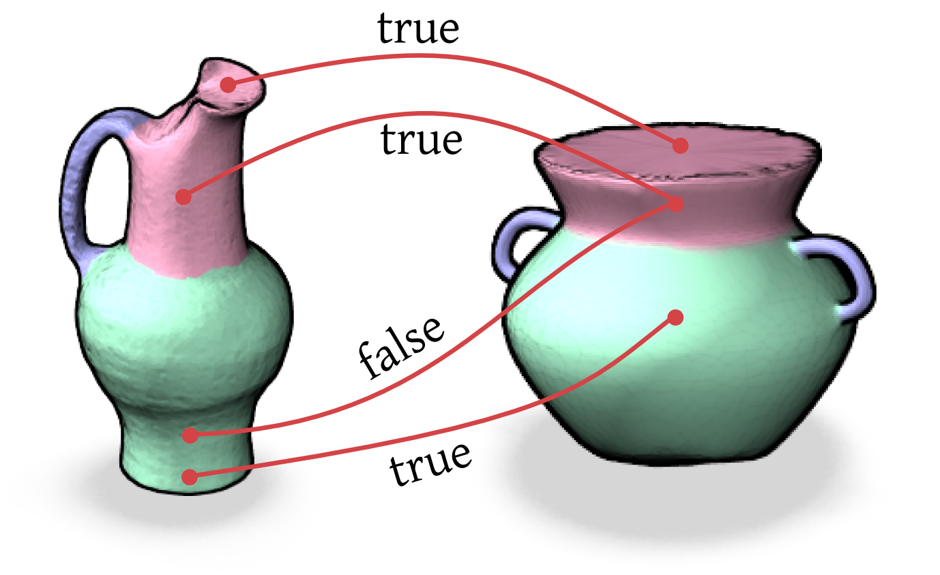
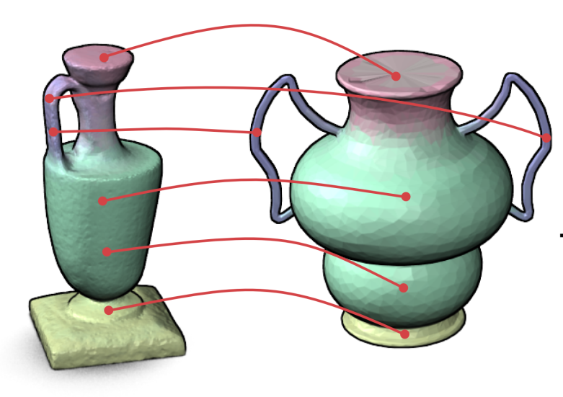
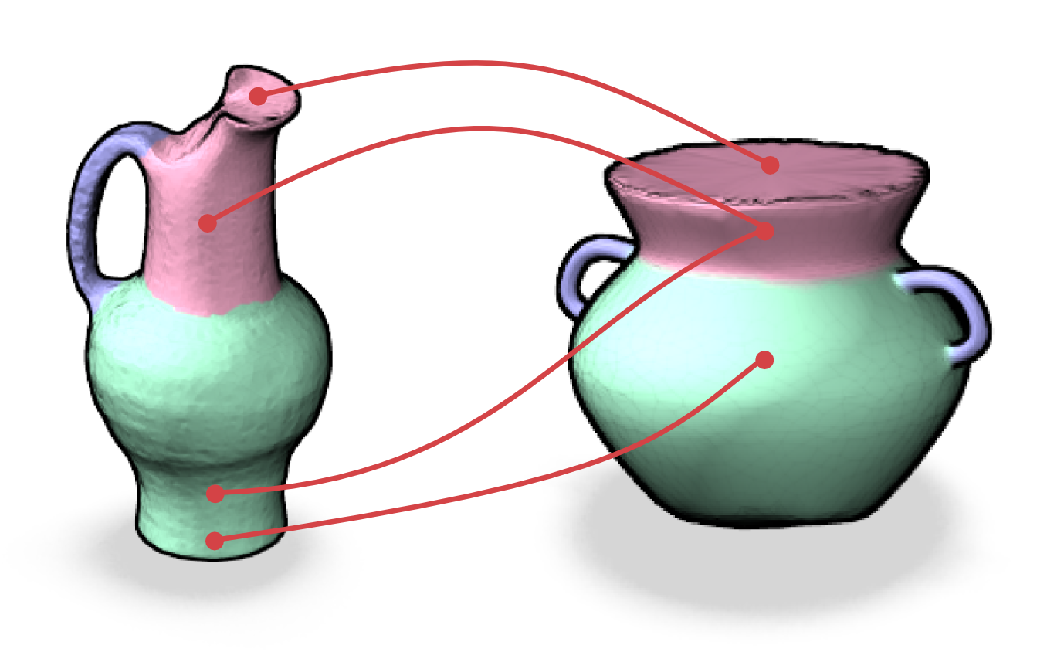
2. Joint labeling: feature pairing
Query shapes
Prior knowledge
Select assignments between corresponding features
Incorporate learning: learn how to distinguish correct from incorrect matches, based on the training set
Notes:
First, we extract feature pairings for those features that have similar descriptors. We also incorporate learning in this step by extracting pairs of matching and not-matching features and training a classifier. More details on this learning are in the paper.

Slide 20
2. Joint labeling: graph labeling
Optimal labeling of a graph given by both shapes
Graph incorporates face adjacencies and the pairwise assignments
Notes:
The problem is the treated as the optimal labeling of a graph. Explain the graph.

Slide 21
2. Joint labeling: labeling energy
Probabilistic
labels
Assignment probability via learning
Edge length
Dihedral angle
Notes:
A labeling energy is defined, and we seek to minimize the energy. Explain each term (the purpose and meaning, but not each symbol).

Slide 22
2. Joint labeling: optimization
Labeling solved with graph cuts[BVZ01]
Optimal parameters are selected with a multi-level grid search on training data
Notes:
Finally, the optimization is solved.

Slide 23
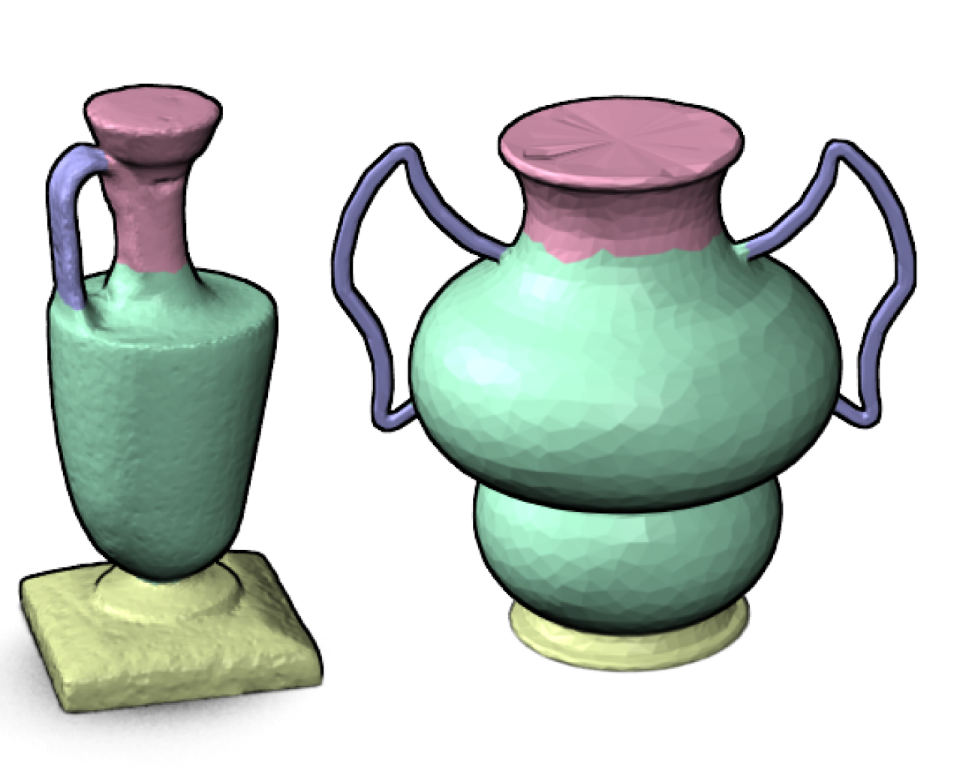
Final result
Deterministic labeling and part correspondence
Notes:
Finally, the optimization is solved.

Slide 24
Experiments
Two datasets
Man-made shapes (our dataset): large geometric and topological variability
Notes:
Experiments set-up.

Slide 25
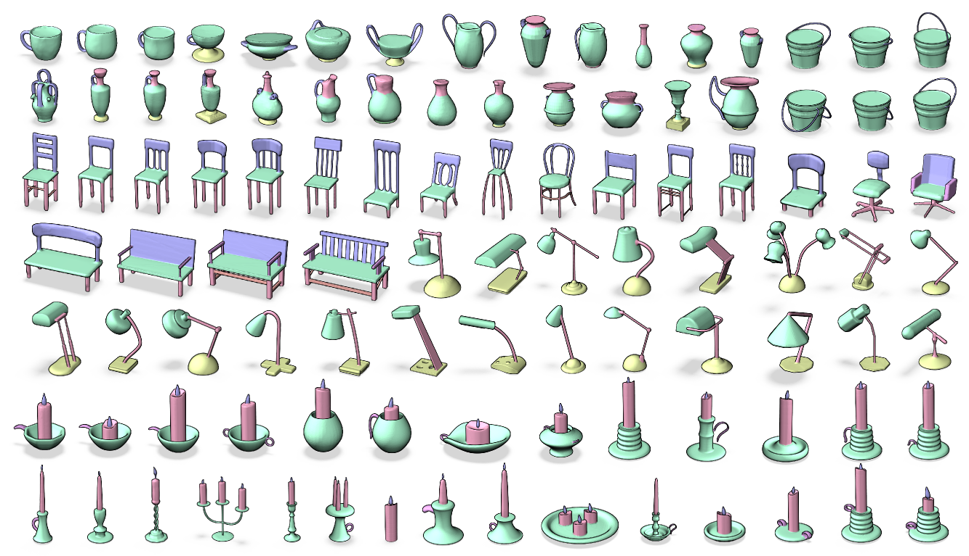
Dataset of man-made shapes

Slide 26
Experiments
Two datasets
Man-made shapes (our dataset): large geometric and topological variability
Segmentation benchmark[CGF09] with the labels of Kalogerakis et al.[KHS10]: we selected organic shapes in different poses
Notes:
Experiments set-up.

Slide 27
Experiments
Two datasets
Man-made shapes (our dataset): large geometric and topological variability
Segmentation benchmark[CGF09] with the labels of Kalogerakis et al.[KHS10]: we selected organic shapes in different poses
60% of training shapes, 40% test
Classifier training: ¾ of training set
Parameter training: ¼ of training set
Notes:
Experiments set-up.

Slide 28
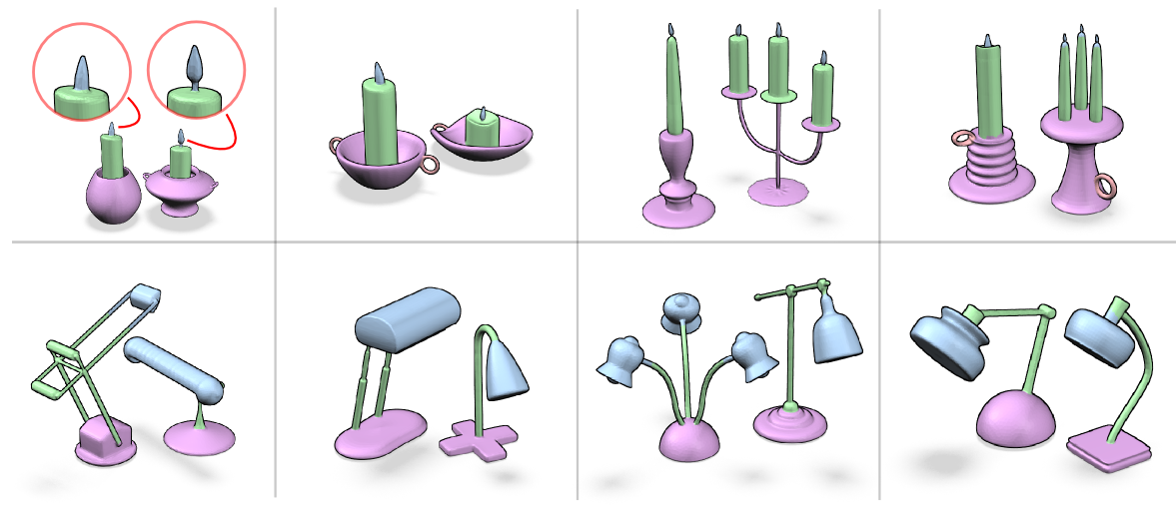
Results: Qualitative comparison
Significant geometry changes and topological variations
Different numbers of parts

Slide 29
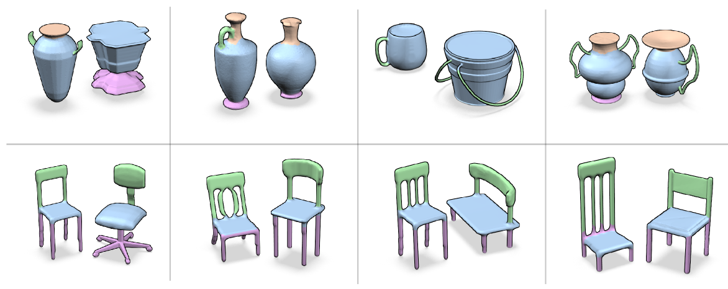
Results : Qualitative comparison
Significant geometry changes and topological variations
Different numbers of parts

Slide 30
Results : Qualitative comparison
Pose variations
Results similar to content-driven methods

Slide 31
Results: Failure cases
Insufficient prior knowledge
Labeling parameters miss small segments
Limitations of the shape descriptors
Notes:
There are some reasons for these failure cases, but the most critical is the lack of sufficient prior knowledge.

Slide 32
Results: Joint labeling
Knowledge only
Knowledge + content
Knowledge only
Knowledge + content
An accurate correspondence can still be obtained when there is enough similarity between the shapes
Notes:
However, we can still obtain good correspondences when there is enough similarity between the shapes.

Slide 33
Results: Statistical evaluation
Class | Corr.
Candle | 88%
Chair | 87%
Lamp | 97%
Vase | 86%
Class | Corr.
Airplane | 92%
Ant | 96%
Bird | 86%
Fish | 92%
Class | Corr.
FourLeg | 82%
Hand | 80%
Human | 90%
Octopus | 96%
90%
89%
Average accuracy over 5 experiments
Label accuracy in relation to ground-truth labeling

Slide 34
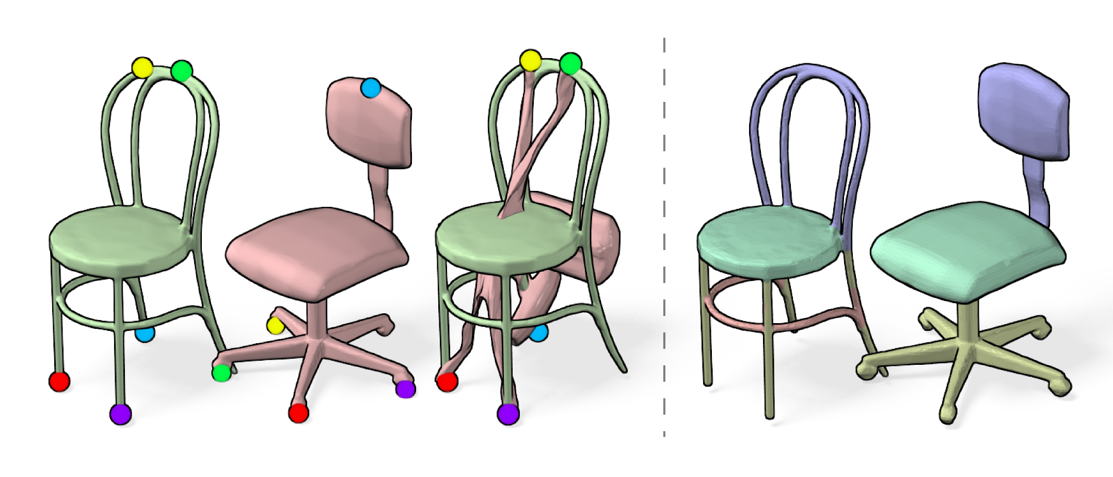
Comparison to content-driven approach
Deformation-driven approach [ZSCO*07]
(Content-driven)
Our approach
Notes:
One of these comparison slides should be sufficient. Probably choose this one.

Slide 35
Conclusions
Challenging correspondence cases are solved
Our approach: Content-analysis (traditional approach) + knowledge-driven
Future work
Unsupervised, semi-supervised method
Improvement in shape descriptors
Ultimate goal: Learn the functionality of parts

Slide 36
Thank you!
We greatly thank the reviewers, researchers that made their datasets and code available, and funding agencies.
Notes:
Choose one of the thank you slides. Probably this one.

